Slide 1
BIP and Summer School 2024 – 4.4.- 31.5. 2024 Social Sciences Going Public - Research and Practice with, in and for the Society Study local urban culture and museums in multi-ethnic and multicultural settings
Explore the potentials and challenges of ‘going public’ in several connected disciplines – anthropology, ethnography, literary studies, and folklore studies – in response to the social, political and ecological issues facing societies and collectives in the diversified Europe of the 21st century.
Kick-Off Meeting
5.4.2024, 15-17 CET/16-18 EET via Zoom

Slide 2
A Warm Welcome To You!

Slide 3
Kick-Off Meeting of Summer School
A Few Words About the CIVIS Network
Introduction of Teachers & Staff
What do we mean with “Going Public”
General – what is the Going Public Approach?
Stream 1: Migration and Diversity
Stream 2: Narratives and Oral Traditions
Stream 4: Museum/Material Culture and Identity
Organisational Matters
Questions?

Slide 4
What is the CIVIS Network?
European Higher Education initiative, founded in 2019
Supported and funded by the European Commission under the Erasmus+ programme.
Network of 11 European and 6 African universities (next slide)
5 ‘hubs’, we are in: “Society, culture, heritage”
Aim: support joint study programmes at Bachelor’s, Master’s and PhD levels at the CIVIS member universities and foster multidisciplinary research projects through innovative pedagogies.
Mission: create a truly unique European inter-university campus where students, academics, researchers and staff will move and collaborate as freely as within their institution of origin!
https://civis.eu/en/about-civis/who-is-civis ; https://civis.eu/en/about-civis/our-mission-and-vision

Slide 5
CIVIS – An alliance of 11 universities, founded 2019
CIVIS is Europe's Civic University Alliance, formed by 11 leading research higher education institutions across Europe: Aix-Marseille Université, National and Kapodistrian University of Athens, University of Bucharest, Université libre de Bruxelles, Universidad Autónoma de Madrid, Sapienza Università di Roma, Stockholm University, Eberhard Karls Universität Tübingen, University of Glasgow, Paris Lodron University of Salzburg and University of Lausanne.
It brings together a community of more than 470,000 students and 58,000 staff members including 35,000 academics and researchers.

Slide 6
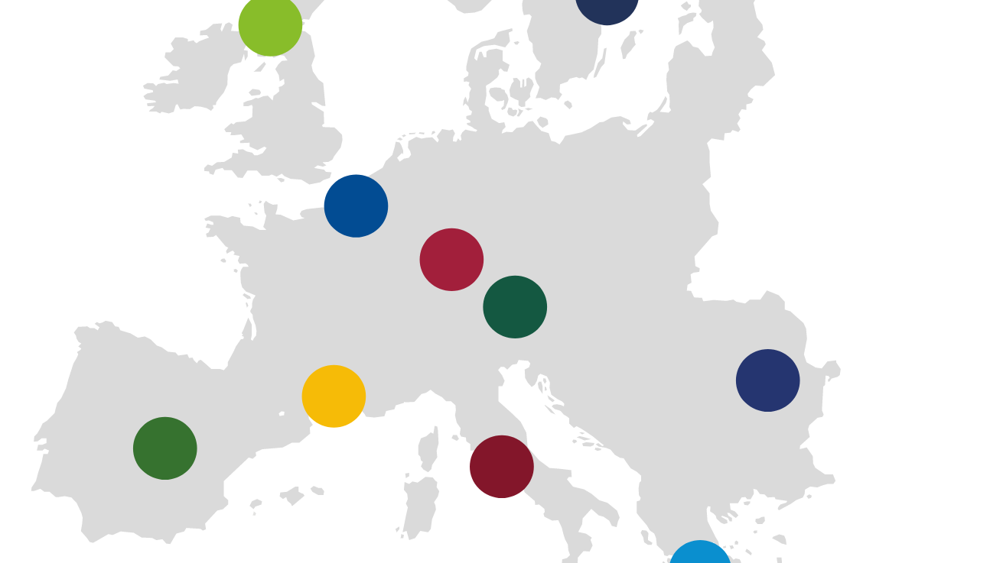
Member Universities
Aix-Marseille Université
National and Kapodistrian University of Athens
University of Bucharest
Université libre de Bruxelles
Universidad Autónoma de Madrid
Sapienza Università di Roma
Stockholm University
Eberhard Karls Universität Tübingen
University of Glasgow
Paris Lodron University of Salzburg
University of Lausanne
African Partner Universities
Makarere University Uganda
Universidade Eduardo Mondlane Mozambique
Université Hassan II de Casablanca Marocco
University of Sfax, Tunisia
Université Cheikh Anta Diop de Dakar, Senegal
University of the Witwatersrand Johannesburg, South Africa

Slide 7
Our HUB 2 - Society, Culture, and Heritage (SCH)
- aims to act as a space for academic collaboration in research-oriented teaching activities. It creates a network of collaborations and seeks to develop joint educational offers, especially at MA and PhD level. We also aim to foster multidisciplinary research projects as, well as public and private partnerships with, for example, museums.
The Hub 2 addresses a broad interdisciplinary field of research and teaching in the areas of “Society, Culture, and Heritage”. As societies face constant change and multiple crises, the Hub strives to promote critical reflection on the historical and theoretical basis of different forms of living together. We explore migration, cultural diversity and identity, community building, multilingualism, cultural participation, and forms of heritage, as well as responsibility in and to the world.

Slide 8
Our HUB 2 - Society, Culture, and Heritage (SCH)
Mediterranean Studies: Diachronic and Intercultural Perspectives
Heritage and Global Epistemologies
Diverse Societies, Inequality and Social Change
Multicultural and Multilingual Communication and Education
Law, Norms, Ethics and Political Institutions
The Hub is currently co-chaired by
Prof. Dr. Dorothee Kimmich
Prof. Dr. Vassiliki Chryssanthopoulou (NKUA).

Slide 9
Our BIP* – Social Sciences GOING PUBLIC, Research and Practice for, in and with the Society
This BIP continues with the BIP activities of 2022 and 2023 with its inter-disciplinary approach that brings together the disciplines of Anthropology, Ethnology, Literature and Folklore Studies (AELF).
The guiding question is how teaching and research at the university can take up applied and public aspects in order to provide solutions to the challenges of modern Europe’s civil societies.
We are especially interested in how civic societies across Europe are responding to and transformed by the larger social, political and ecological issues facing societies and collectives in the diversified Europe of the 21st century
*(Blended intensive programme)

Slide 10
Our BIP – (Blended intensive programme)
This BIP continues with the BIP activities of 2022 and 2023 with its interdisciplinary approach that brings together the disciplines of Anthropology, Ethnology, Literature and Folklore Studies (AELF). The guiding question is how teaching and research at the university can take up applied and public aspects in order to enhance learning and comprehension as well as to provide solutions to the challenges of modern Europe’s civil societies. We are especially interested in how civic societies across Europe are responding to and transformed by the larger social, political and ecological issues facing societies and collectives in the diversified Europe of the 21st century

Slide 11
Dates and Meetings (Fridays – 3-5/4-6 p.m.)
5 April 2024 – Introduction and Welcome
12 April 2024 – Lecture: Public Anthropology by Tomás Criado FROM 10-12 CET / 11-13 EET via zoom
19 April 2024 – Working Group Meeting I - ZOOM
26 April 2024 – Working Group Meeting II - ZOOM
3 May 2024 – Working Group Meeting III - ZOOM
13-17 May – SUMMERSCHOOL Tübingen
13. May - Evening Dinner, 16. May - Excursion
31 May 2024 – Consultation Meeting for Essay Writing

Slide 12
12.4. 2024 10/11 am Lecture via Zoom
A Publics’ Anthropology: Setting up ecologies of collective speculation
Tomás Criado, Open University of Catalonia
I’ll share with you two recent projects working with municipal actors setting up ecologies of collective speculation: the game Waste What?, an interdisciplinary team production as part of studying activist circular economy projects in Berlin, searching to simulate the conundrums of these initiatives as well as provoke a reflection on their predicaments; and the Department of Umbrology, a collective speculative experiment equipping a proto-municipal division to inquire on the social dimensions of heat mitigation projects, in the hope that his might sensitise technical professionals to consider the social in the plural.

Slide 13
Introduction of Teachers & Staff
Athens: Vassiliki Chryssanthopoulou Georgios Kouzas | Bucharest: Ioana Fruntelata Adrian Stoicescu Gabriel Tamas
Student Assistants: Rares Jeflea; Julia Braun Bianca Muntenau Katerina Sxoina Antonia Jeflea | Tübingen: Gabriele Alex Heidrun Eichner Julia Faulhaber

Slide 14
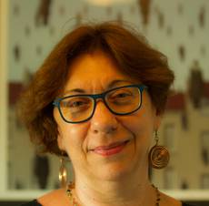
Vassiliki Chryssanthopoulou, University of Athens Associate Professor of Folklore & Social Life
Fields of Interest:
Migrants and refugees
Ethnicity, diaspora, regionalism and transnationalism
Digital ethnography
Religion, ritual and cosmologies
Public folklore and heritage
Museums and archives
Theory and history of Folklore in Greece
Stream 1: Migration and Diversity (with Adrian Stoicescu)

Slide 15
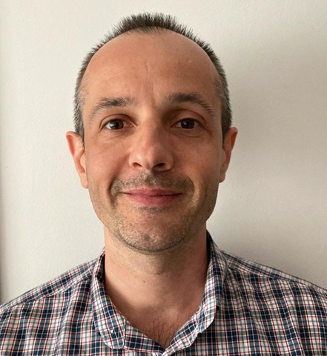
Adrian Stoicescu, University of Bucharest Associate Professor of Ethnology
Fields of Interest:
Digital Anthropology
Folk cultures
Verbal arts
Everyday life
Stream 1: Migration and Diversity (with Vassiliki Chryssanthopoulou)

Slide 16
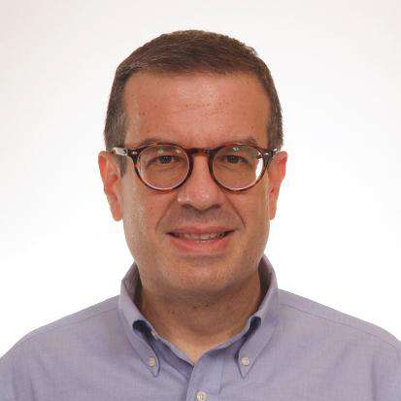
Georgios Kouzas, University of Athens Assistant Professor of Urban Folklore
Fields of Interest:
Urban Folklore and Urban Space
Narratives and Oral Histories
New Narrative Forms (Urban legends, Conspiracy Theories, etc.)
Narratives- Minor Genres (Gossip, Rumors etc.)
Stream 2: Narratives and Oral Traditions (with Marianthi Kaplanoglou)

Slide 17
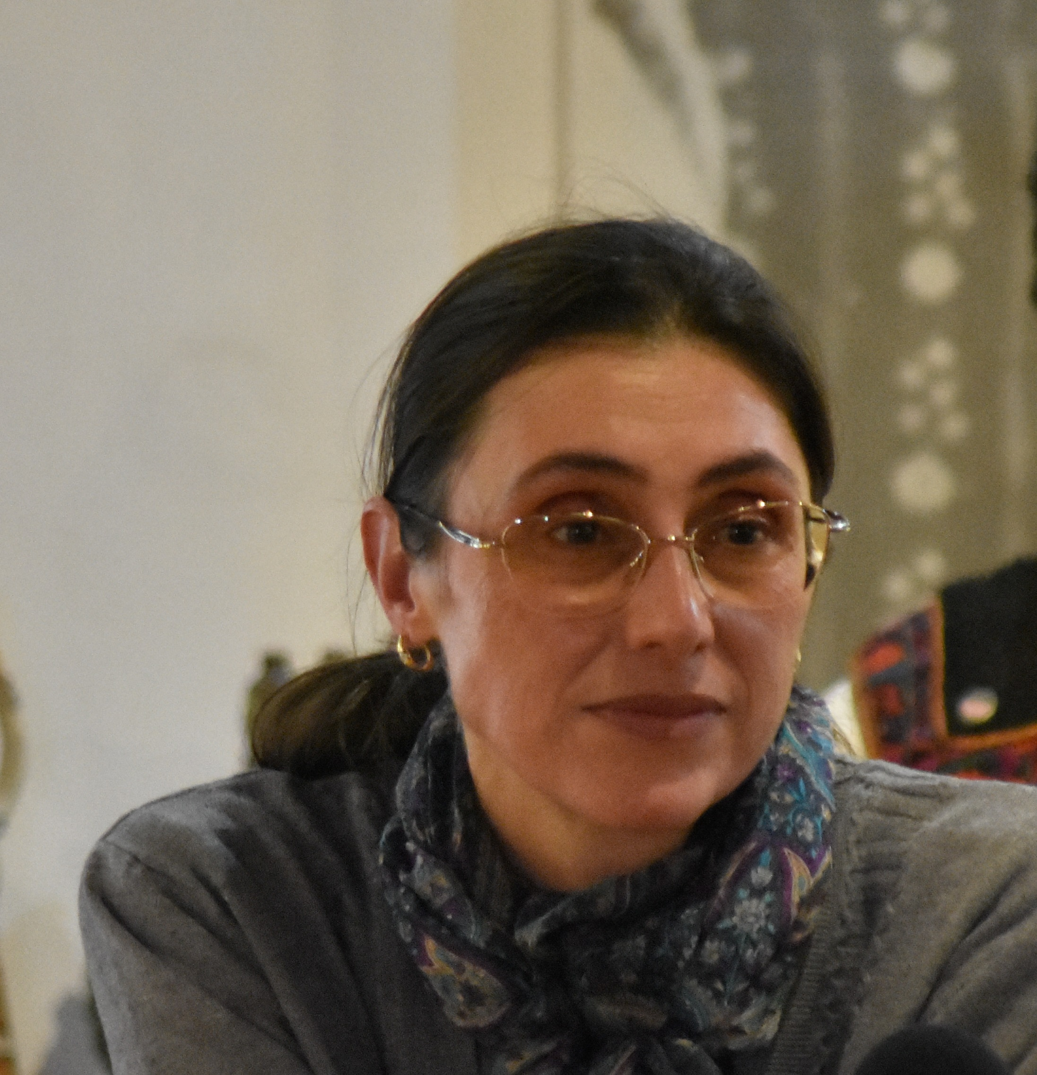
Ioana Fruntelată, University of Bucharest Professor of Ethnology and Folklore
Fields of Interest:
Intangible cultural heritage and heritigization
Personal narratives ------
Religious experience
Ritual expressions in informal cultures
Poetics of orality
Romania, Balkan region--------
Stream 3: Museum/Material Culture and Identity
(with Gabriele Alex and Heidrun EIchner)

Slide 18
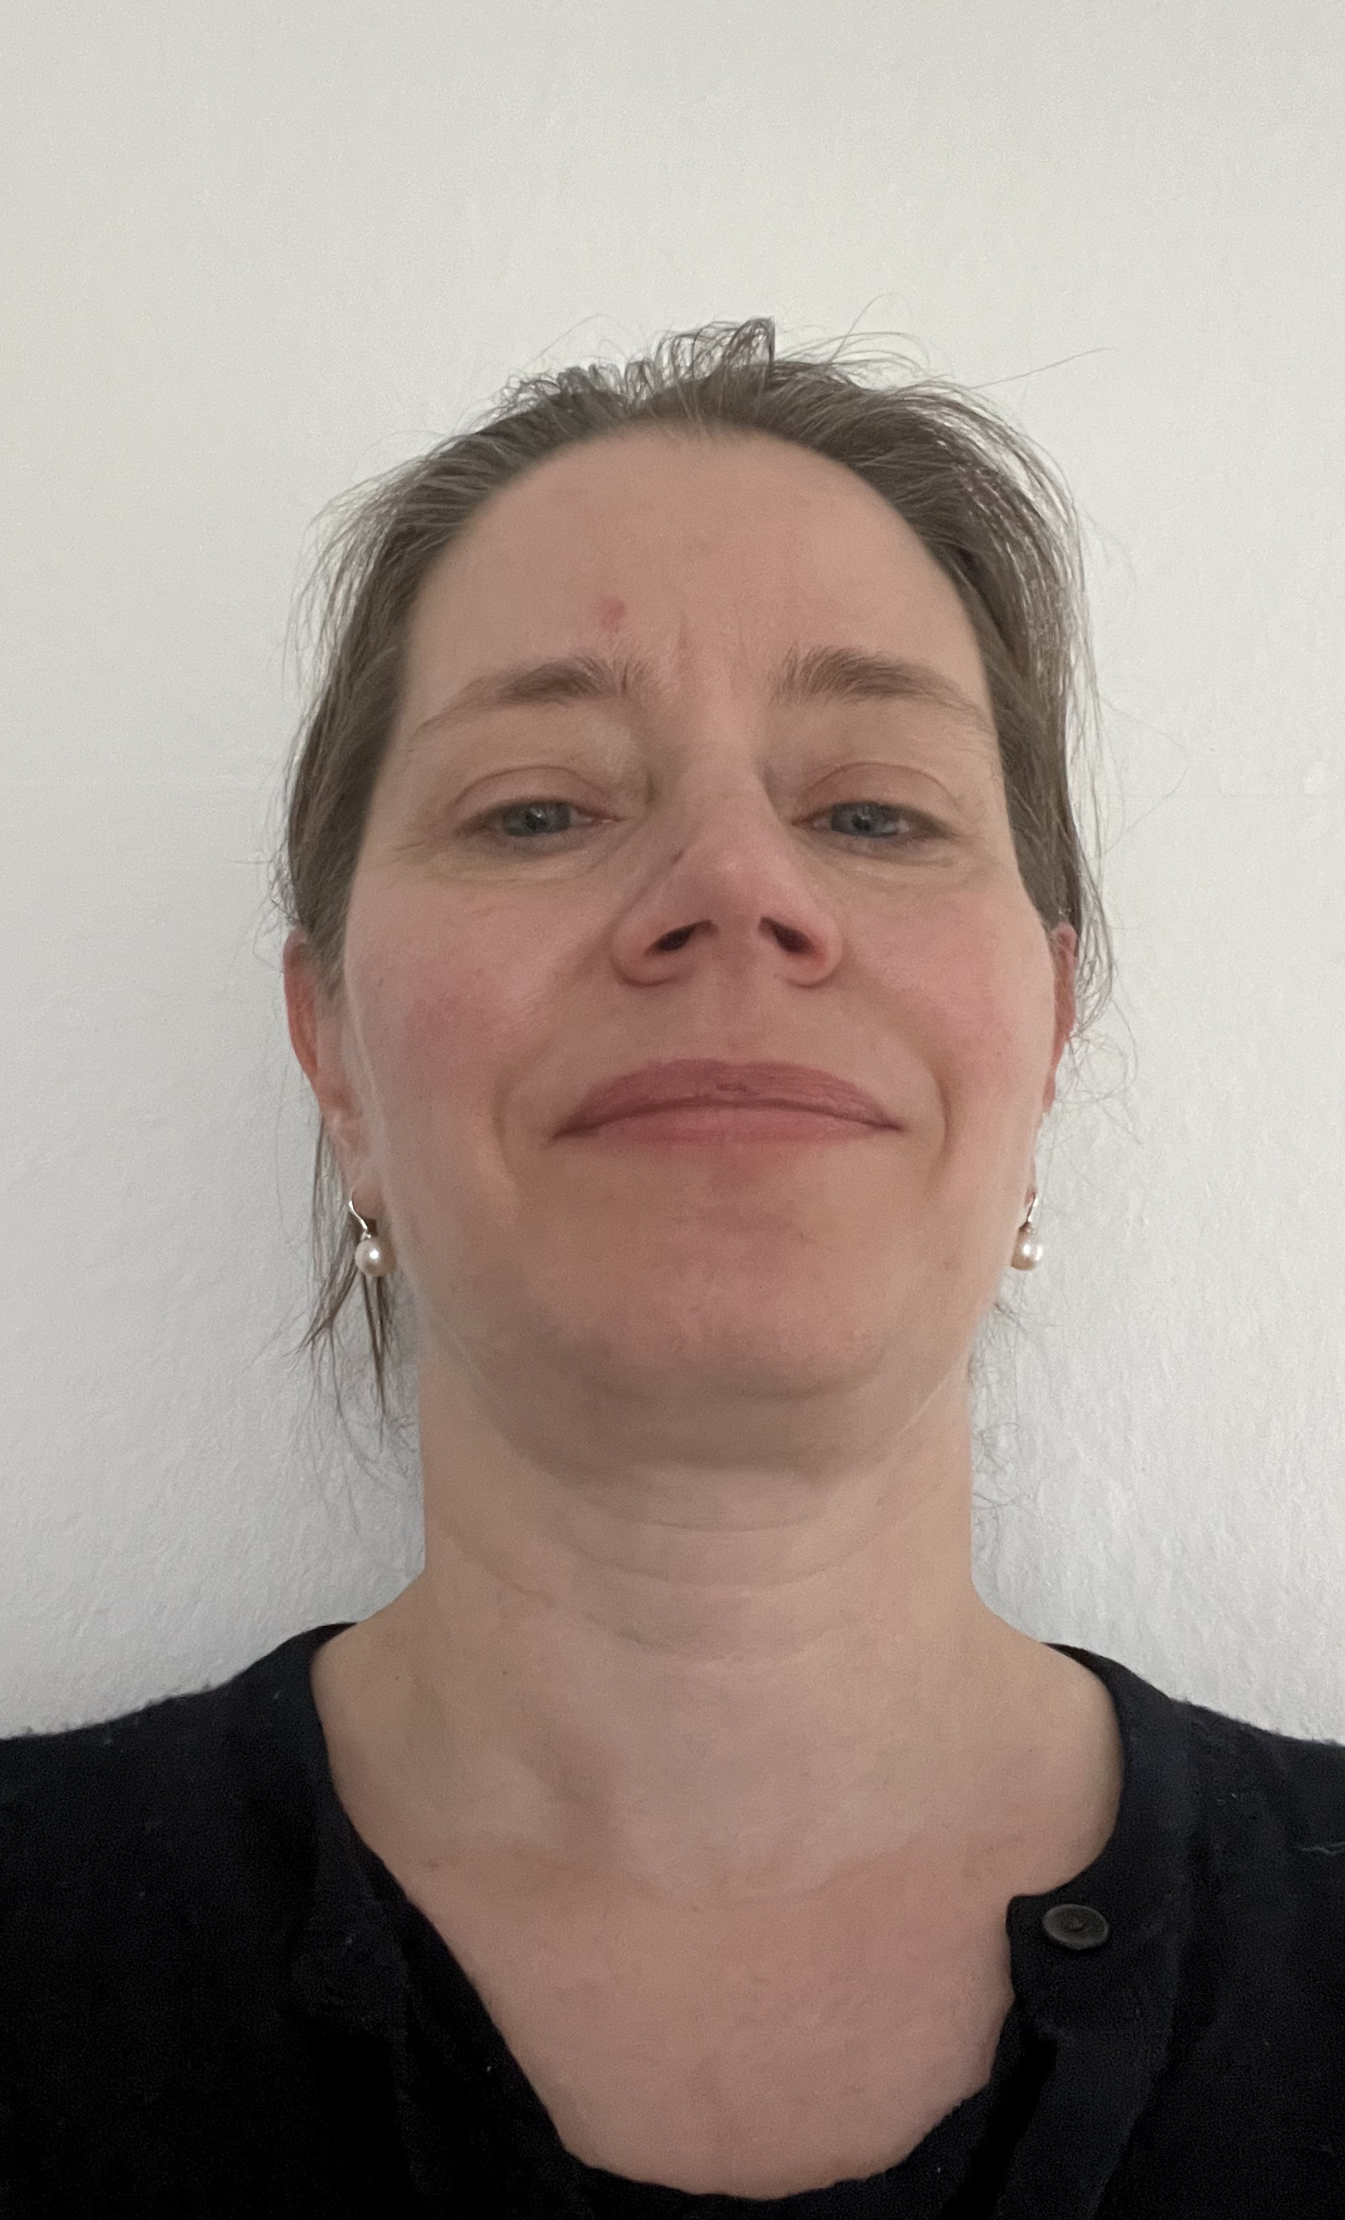
Heidrun Eichner, University of Tübingen Professor of Islamic Studies
Fields of Interest:
Islamicate Intellectual History
Religious Identities in Classical Islam
Tralation Philology (Greek into Arabic,
Hebrew and Latin)
Presentation of Islamic religion in Museums
Stream 3: Museum/Material Culture and Identity
(with Gabriele Alex und Ioana Fruntelata)

Slide 19
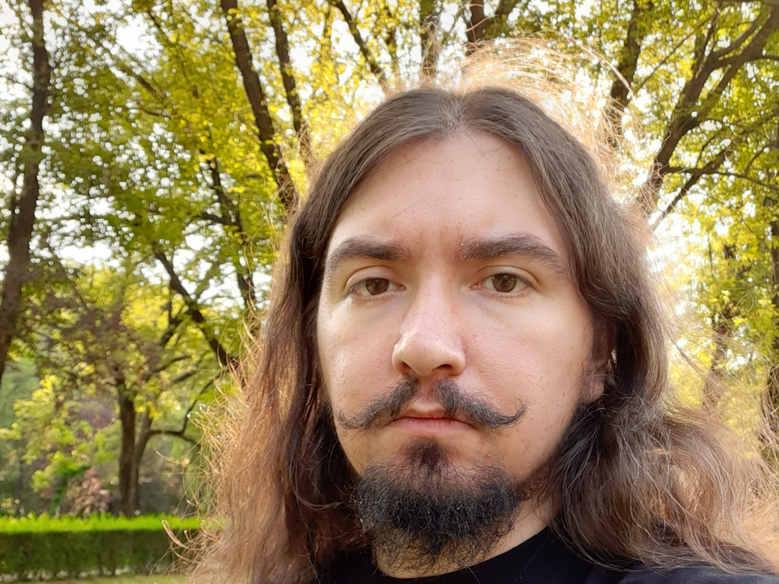
Gabriel Tamas, University of Bucharest Associate Professor
Fields of Interest:
Oral narratives (with a focus on myth and
legend)
Urban anthropology
Memes and Digital culture
Visual narration
Stream 2: Narratives and Oral Traditions (with Georgios Kouzas and Julia Faulhaber)

Slide 20
Julia Faulhaber, University Tübingen Junior Lecturer in Social and Cultural Anthropology
Fields of Interest:
Jamaica
Anthropology of Youth
Anthropology of Sport
Stream 2 together with Georgios Kouzos, Gabriel Tamas,
Katerina Sxoina

Slide 21
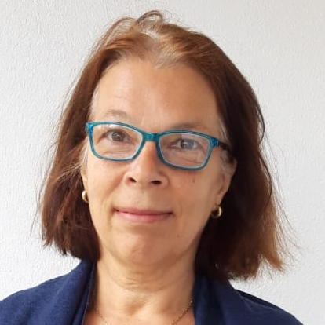
Gabriele Alex, University Tübingen Professor of Social and Cultural Anthropology
Fields of Interest:
Medical Anthropology
Anthropology of Childhood
Museums in the 21st Century
Myths, Oral Tradition and Cosmological Histories
India, esp. South India and Greece
Stream 3 together with Ioana Fruntelata:
Museum/Material Culture and Identity

Slide 22
Student Assistents
Rares Jeflea: Rares is a PhD student in Historical and Cultural Anthropology at University of Tuebingen. He researches private collections built around Romanian football teams and how these are intertwined with fandom subculture, nationalism, and urban representation. (STREAM 3)
Katerina Sxoina: Katerina is a the Secretary of the CIVIS Global Student Council and a PhD student in Folklore Studies in the Faculty of Philology at the School of Philosophy of the National and Kapodistrian University of Athens (NKUA). In her doctoral thesis, she studies the folkloristic approaches to natural disasters, due to climate change in the Prefecture of Attica (2000 - 2020), through traumatic memories, narratives and collective representations. (STREAM 2)
Julia Braun: Julia is a BA student at Tübingen University, she works on Migration and Diversity (STREAM 1)

Slide 23
Student Assistents
Antonia Jeflea: Antonia is a PhD student in Empirical Cultural Studies at the University of Tübingen, working on a thesis about migration paths of Romanian blue-collar workers in Germany. Her research interests are migration, diasporas, (e-) governance, and digital diasporic communities. (STREAM 1)
Bianca Montenau: is a PhD student in Cultural Studies at University of Bucharest. Her research has as a core the Romanian diaspora from Madrid, Spain analysed through the lenses of homesickness and the five senses. Her main interest is to discover how identity is shaped and reshaped in the context of migration.
Martha Shering: Martha is a MA Student in Tübingen University and a student assistant, she will be of assistance at some relevant events.

Slide 24
What do we mean with “Going Public”
Not just work with and speak about communities, but also to actively engage with them, identify problems and work jointly on solutions.
Explore social and communal issues, what their impact is in the everyday life and experiences of people and communities.
How people think about these issues and respond to them and how they build communities around these issues.
Link teaching and research at universities with those Public issues in a meaningful way

Slide 25
Migration and Diversity – Diaspora, Transnationalism and Asylum
Prof. Vassiliki Chryssanthopoulou, Prof. Adrian Stoicescu, Antonia Jeflea, Bianca Munteanu, Judith Riepe
Students will become acquainted with the key concepts, theories and methods in connection with the study of diaspora, migration, refugees and exile.
We will investigate the social and cultural diversity in the context of migration and multi-ethnic dwelling in a comparative perspective and, at the same time, we will examine transnational ways and strategies among diasporic individuals and communities.
We will analyse the concepts of crisis, diaspora (national and ethno-regional), heritage, trauma, memory, postmemory, rootedness, deterritorialization, nostalgia,
homecoming and transnational practices, and, equally, digital diasporas, connected users and their imagined sense of belonging.

Slide 26
STREAM 1 - Migration and Diversity – Diaspora, Transnationalism and Asylum
Prof. Vassiliki Chryssanthopoulou, Prof. Adrian Stoicescu, Antonia Jeflea, Bianca Munteanu, Judith Riepe
Learning Outcomes – Students will:
Gain theoretical knowledge by studying researches carried out in connection with key concepts pertaining to migration, refugee status and diversity
Gain practical experience by conducting research in classical and digital ethnographic fields
Understand how displaced individuals tackle their everyday lives between the two ‘homes’
Build on collaborative work in order to present their research findings

Slide 27
STREAM 2: Narratives and Oral Traditions: Georgios Kouzas (Athens), Gabriel Tamas, (Bukarest), Julia Faulhaber (Tübingen) Main axes:
This stream introduces to a total study of the diversity of oral performance situations in communities, conceiving local narrators not as passive tradition bearers, but rather as active agents in the reappropriation of existing traditions. We will study how members of a given folk group negotiate their social relations and attitudes not only through actions but also through artistic oral communication, its genres, themes and symbols. Based on a comparative perspective, we will also see the circulation of certain of these themes and motifs in Europe.
In a second level this workshop will focus on modern forms of orality in modern urban space like urban legends, gossip and rumors. Especially, we will investigate how the issue of both public and private life, and how public events (even in the micro–level of the neighborhood or the macro–level of the city or the country where we live) pass to the private area through daily narrations.

Slide 28
Narratives and Oral Traditions
The scientific standpoint (Folklore studies): The activity of a folklorist is to record in order to analyze and interpret, not to preserve and display. Folklore is not an aggregation of things but a dynamic communicative process. Orientation of folklore studies towards the social function of folklore in situated practices – scholarly focus on singers and narrators as individual performers and as members of social groups and their interplay in everyday life. Oral traditions are open-ended processes shaped by the inter-play between individually generated variations on the one hand, and selection criteria upheld by historically changing communities on the other.

Slide 29
Renewal of orality in urban spaces
As most acts of folklore, legends tend to be updated and contextualised to better fit the contemporary realities. This renewal is a change of form, but a conservation of essence.
As orality manifests itself in newer channels (internet, memes) it needs constant reevaluation in order to further understand its phenomena.
Focus:
an understanding of the distinction between classical legends and contemporary legends, judging based on their diachrony and functions;
the possible mutations of function experienced by this type of narration;
dissemination of legendary narrations and its relevance in a contemporary setting

Slide 30
Learning outcome
Gain practical experience in folk narrative research:
Understand how orality “works”. Understand the contemporary dimension of the narrative procedure.
The itinerary of a narrative, in varied traditions - its oral variants and/or written texts (historical axis).
The narrator’s individual choices, emotions and transformations in regard to a narrative’s established storyline (individual axis).
The self-contained aesthetic and poetic language of the narrative genre.

Slide 31
STREAM 3 Museum, Material Culture and Identity - Gabriele Alex, Ioana Fruntelata, Heidrun Eichner, Rares Jeflea
Students will explore - with the help of collaborative methods of museum anthropology – cultural heritage sites in Tübingen and around, in order to ask how collective/individual memory, identities, understandings of national or cosmopolitan belonging are framed and expressed in and through material culture.
We will visit different sites, like the Tübingen Stadtmuseum, the Museum of the University Tübingen (MUT), memorial sites related to the WW2 and to the Shoa as well as Cloister Bebenhausen.

Slide 32
STREAM 3 Museum, Material Culture and Identity - Gabriele Alex, Ioana Fruntelata, Heidrun Eichner, Rares Jeflea
In small teams guided by the stream teachers, students will collect the 'voices' of community members, curators and museum audiences. They will reflect in different research settings on interconnections with materiality and everyday socio-cultural settings as well as different historical periods that relate to different identities, heritages, belongings and values .
At the end of the summer school students will create a collaborative display of their research outcomes.

Slide 33
STREAM 3 Museum, Material Culture and Identity - Gabriele Alex, Ioana Fruntelata, Heidrun Eichner, Rares Jeflea
Learning Outcome:
Gain practical experience in designing, conducting and reflecting on/of collaborative research methods of museum anthropology
Gain practical experience of creating a collaborative & polyphonic display of their findings
Understand how contemporary processes of memory-making are part of creating a community history & the everyday culture
Understand through their exemplary research how concepts of belonging evolve
Understand how materiality and everyday community culture are reciprocally interconnected

Slide 34
Organisational Matters
Venue: Neue Aula, Wilhelmstrasse
Tübingen in May
Assistance in Tübingen
Julia Braun, Martha Shering
Contact with German Students

Slide 35
Important - Please inform us:
If you havent been added to a stream yet
If somebody you know who enrolled, is not in the email distribution list
If you are not coming to Tübingen - please immediately inform us
If something is wrong with accomodation booking
Any other questions/doubts - contact us☺

Slide 36
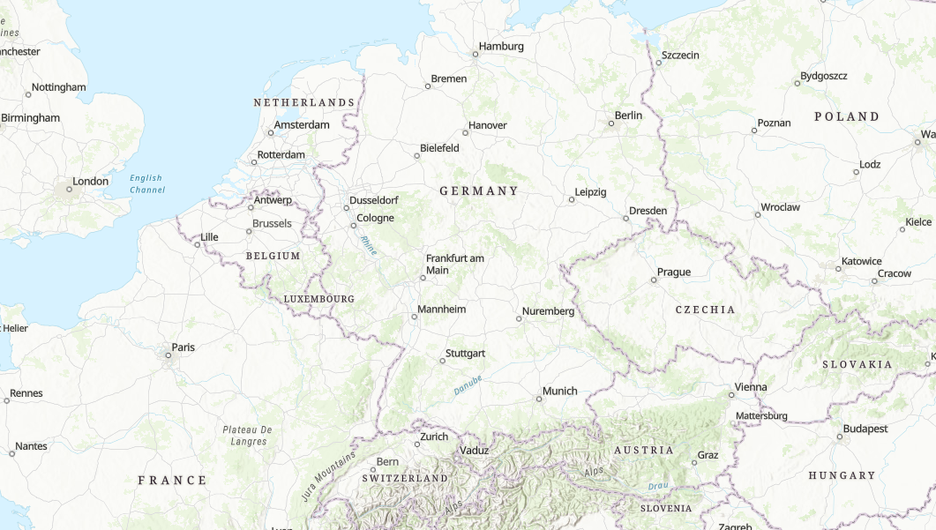
Where is Tuebingen?

Slide 37
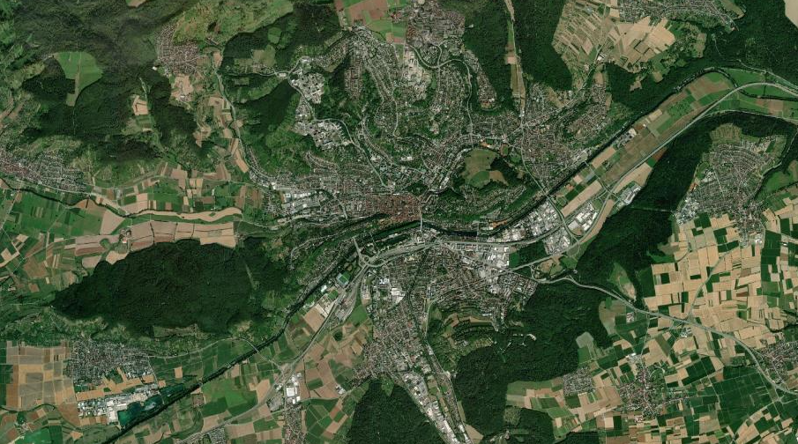
Tuebingen along the Neckar River

Slide 38
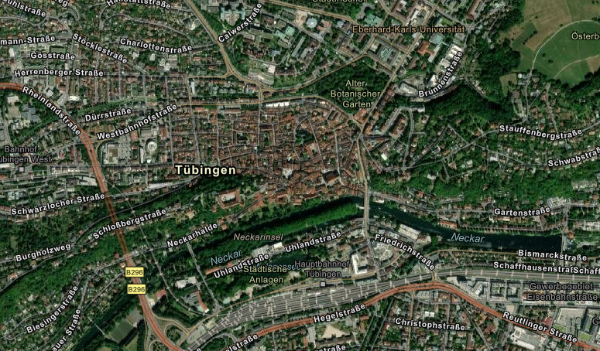
Tuebingen Upclose
Venue: Neue Aula – Room name: ‘Großer Senat’
Main Station

Slide 39
Tübingen - Town Hall

Slide 40
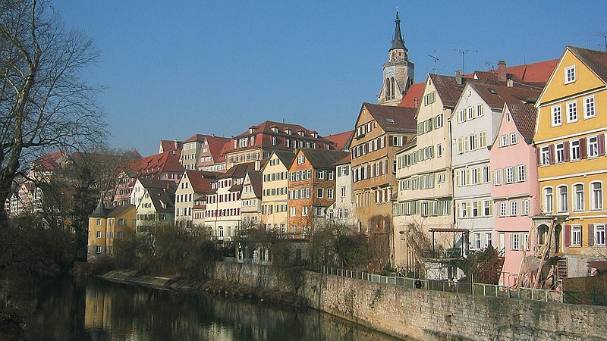
Tübingen - River

Slide 41
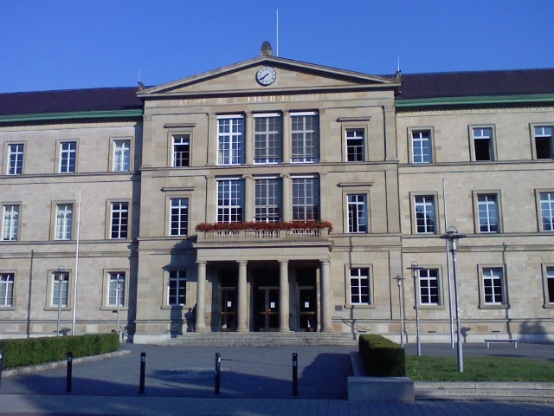
Tübingen – Neue Aula, Wilhelmstrasse 7-9 Room : Großer Senat

Slide 42
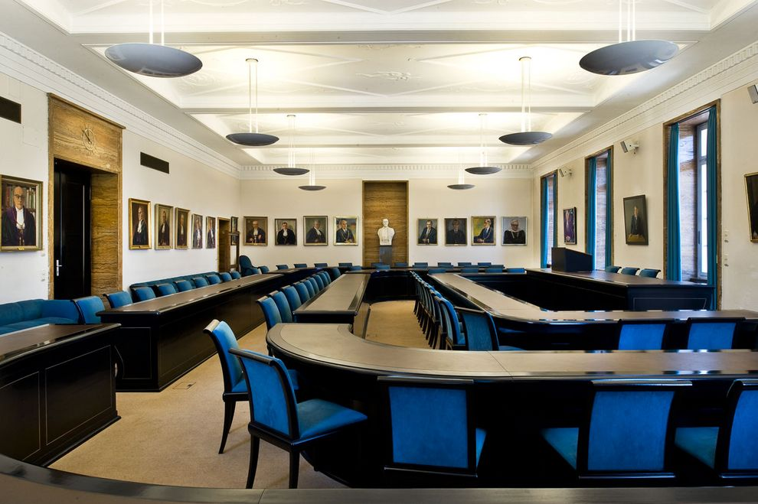
Room : Großer Senat

Slide 43
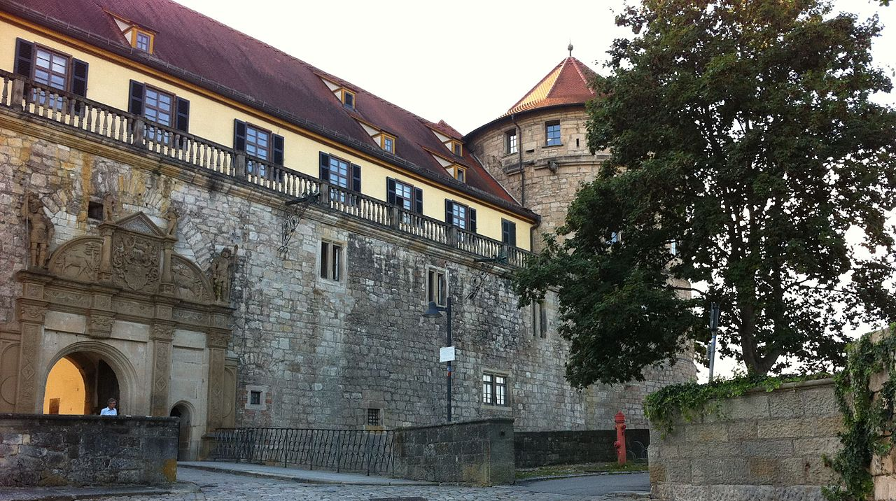
Tübingen - University – Dep. of Social and Cultural Anthropology

Slide 44
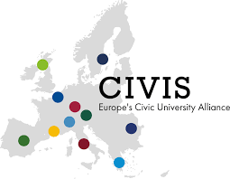
Questions?

