Slide 1
Philosophische Fakultät
Abt. für Ethnologie, Asien-Orient-Institut
Introduction
MA Programme
Social and Cultural Anthropology
at the Universität Tübingen
WS 2021/2
21.10.2020 © 2019 University of Tuebingen
Notes:
1

Slide 2
MA Programme Social and Cultural Anthropology/Ethnologie
2 | © 2019 University of Tuebingen

Slide 3
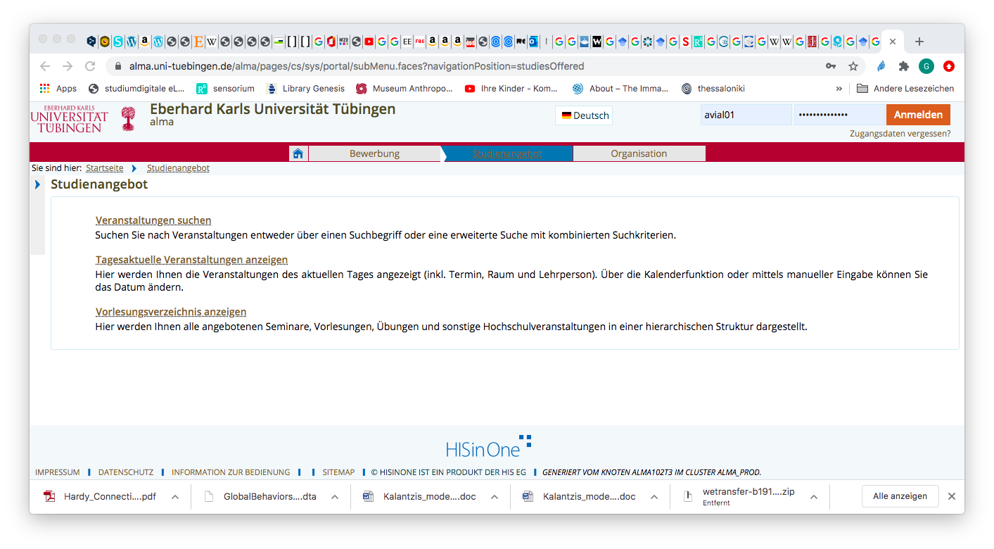
How to register at: ALMA

Slide 4
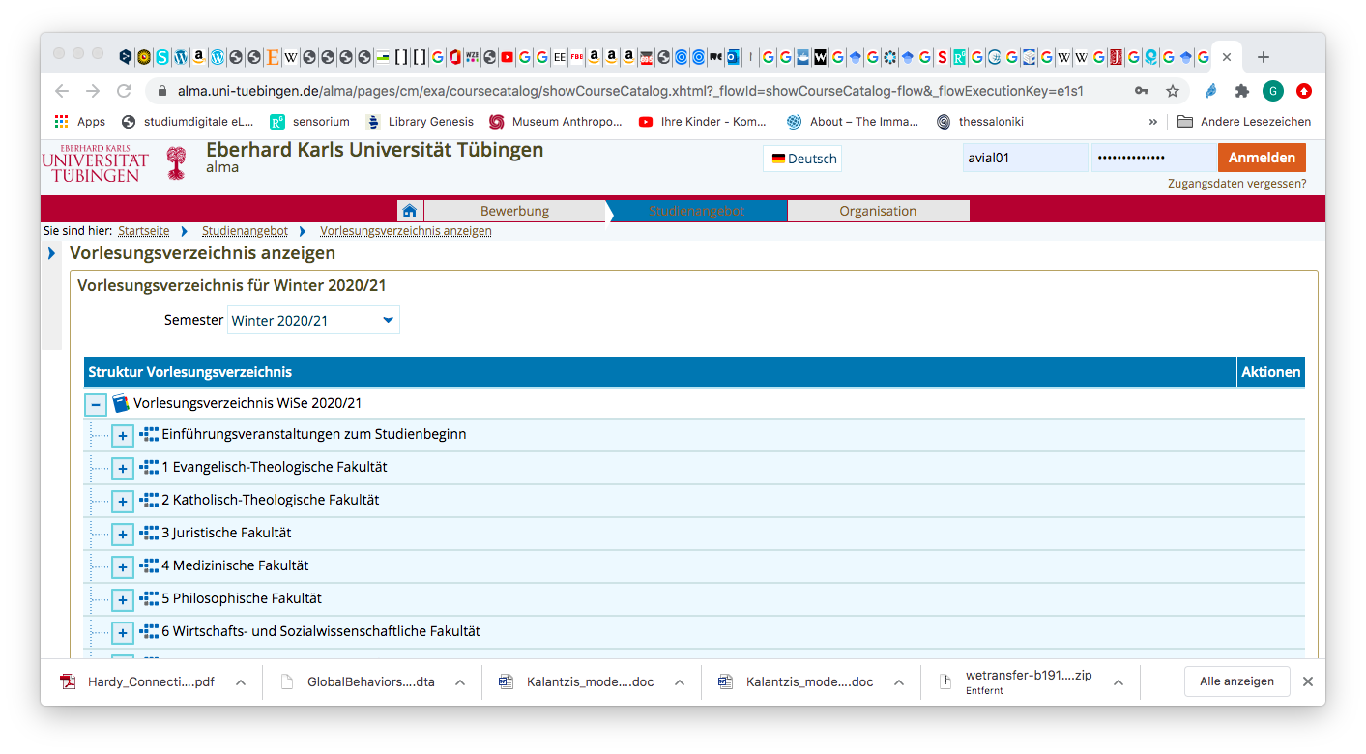

Slide 5
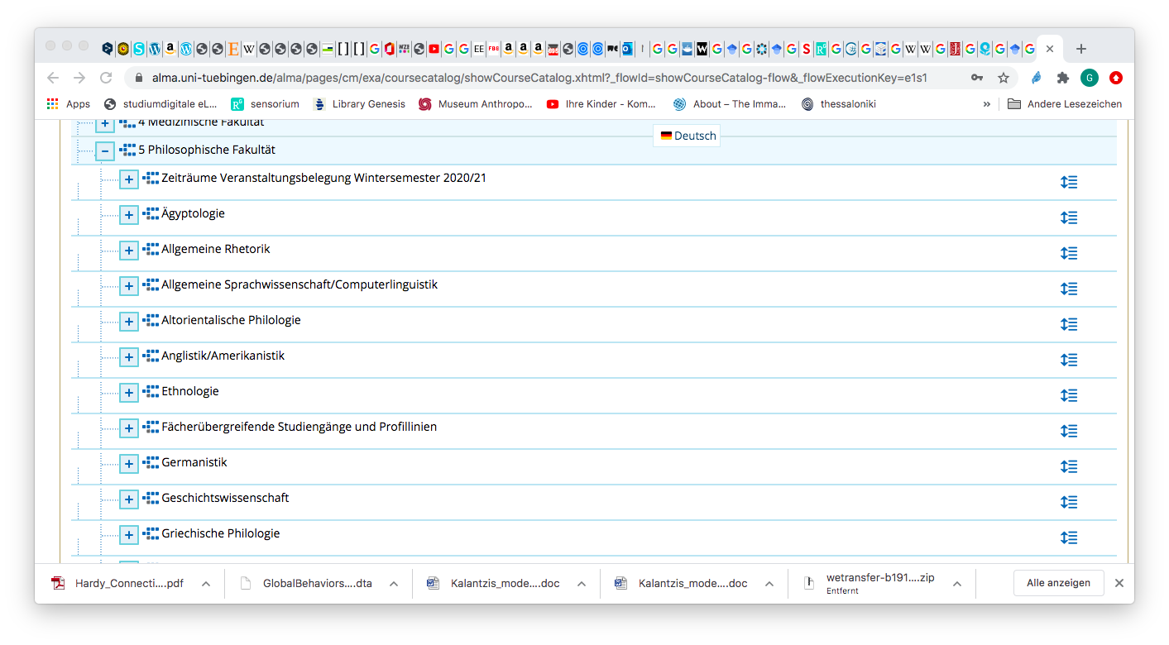

Slide 6
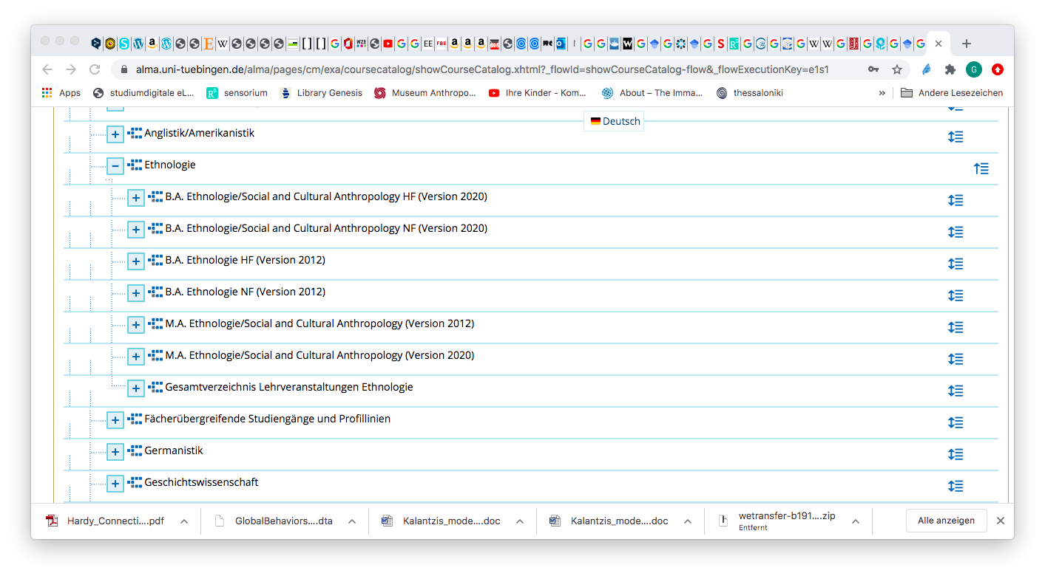

Slide 8
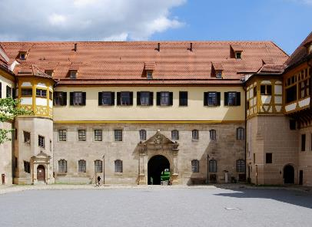
Introductionary Meeting
An introduction for all fresh MA students will take place on the 27th of October from 16.00-18.00, there will be a social event following this at 18.00 - ‘meet, greet and drinks’ in the museum.
You will meet the staff and students and get a tour through the Department of Social and Cultural Anthropology.
Looking forward to seeing you soon!
33 | © 2019 University of Tuebingen

