Slide 1
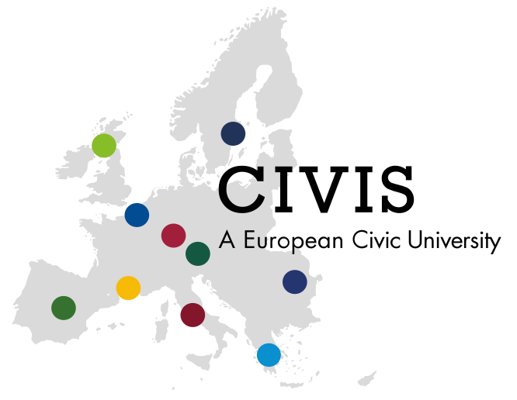
Summer School
Going public: Social Sciences and Humanities in the 21st century in Europe
Explore the potentials and challenges of ‘going public’ in several connected disciplines – anthropology, ethnography, literary studies, and folklore studies – in response to the social, political and ecological issues facing societies and collectives in the diversified Europe of the 21st century.
Kick-Off Meeting
5.5.2022, 9-11 (Berlin time) via Zoom

Slide 2
A Warm Welcome To You!

Slide 3
Kick-Off Meeting of Summer School
A Few Words About the CIVIS Network
Introduction of Teachers & Staff
What do we mean with “Going Public”
  General – what is the Going Public Approach?
  Stream 1: Migration and Diversity
  Stream 2: Narratives and Oral Traditions
  Stream 3: Material Culture and Ecology: Topics in Public Anthropology
  Stream 4: Material Culture and Identity
Organisational Matters
Questions?

Slide 4
What is the CIVIS Network?
European Higher Education initiative, founded in 2019
Supported and funded by the European Commission under the Erasmus+ programme.
Network of 10 European and 6 African universities (next slide)
5 ‘hubs’, we are in: “Society, culture, heritage”
Aim: support joint study programmes at Bachelor’s, Master’s and PhD levels at the CIVIS member universities and foster multidisciplinary research projects through innovative pedagogies.
Mission: create a truly unique European inter-university campus where students, academics, researchers and staff will move and collaborate as freely as within their institution of origin!
https://civis.eu/en/about-civis/who-is-civis ; https://civis.eu/en/about-civis/our-mission-and-vision

Slide 5
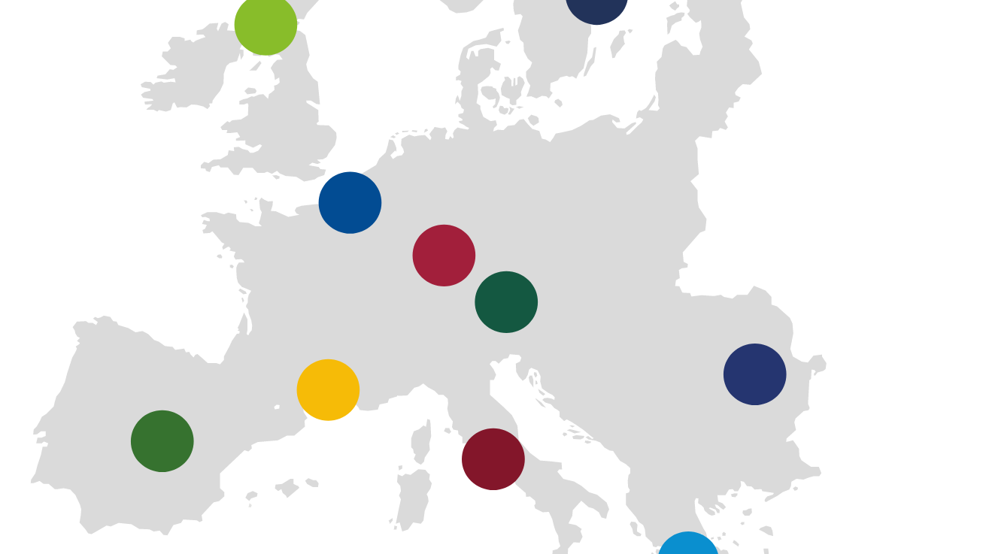
Member Universities
Aix-Marseille Université
National and Kapodistrian University of Athens
University of Bucharest
Université libre de Bruxelles
Universidad Autónoma de Madrid
Sapienza Università di Roma
Stockholm University
Eberhard Karls Universität Tübingen
University of Glasgow
Paris Lodron University of Salzburg
African Partner Universities
Makarere University Uganda
Universidade Eduardo Mondlane Mozambique
Université Hassan II de Casablanca Marocco
University of Sfax, Tunisia
Université Cheikh Anta Diop de Dakar, Senegal
University of the Witwatersrand Johannesburg, South Africa

Slide 6
Introduction of Teachers & Staff
Athens: Vassiliki Chryssanthopoulou Marianthi Kaplanoglou Georgios Kouzas | Bucharest: Claudia N. Câmpeanu Magdalena Crăciun Adrian Stoicescu
Stockholm: Sarah Holst Kjaer | Tübingen: Gabriele Alex Karin Polit

Slide 7
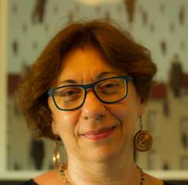

Vassiliki Chryssanthopoulou, University of Athens
Associate Professor of Folklore & Social Life
Fields of Interest:
Migrants and refugees
Ethnicity, diaspora, regionalism and transnationalism
Digital ethnography
Religion, ritual and cosmologies
Public folklore and heritage
Museums and archives
Theory and history of Folklore in Greece
Stream 1: Migration and Diversity
(with Adrian Stoicescu)

Slide 8
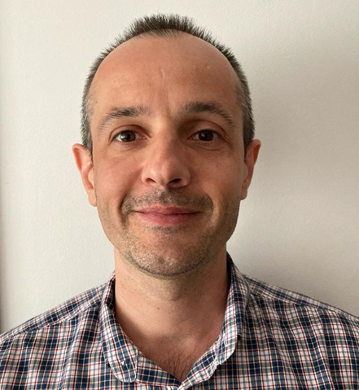

Adrian Stoicescu, University of Bucharest
Associate Professor of Ethnology
Fields of Interest:
Digital Anthropology
Folk cultures
Verbal arts
Everyday life
Stream 1: Migration and Diversity
(with Vassiliki Chryssanthopoulou)

Slide 9
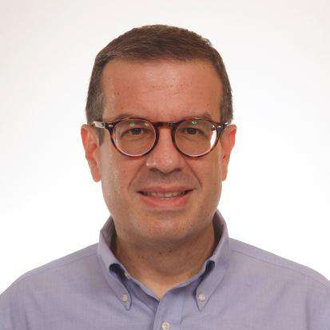
Georgios Kouzas, University of Athens
Assistant Professor of Urban Folklore
Fields of Interest:
Urban Folklore and Urban Space
Narratives and Oral Histories
New Narrative Forms
(Urban legends, Conspiracy Theories, etc.)
Narratives- Minor Genres
(Gossip, Rumors etc.)
Stream 2: Narratives and Oral Traditions
(with Marianthi Kaplanoglou)

Slide 10
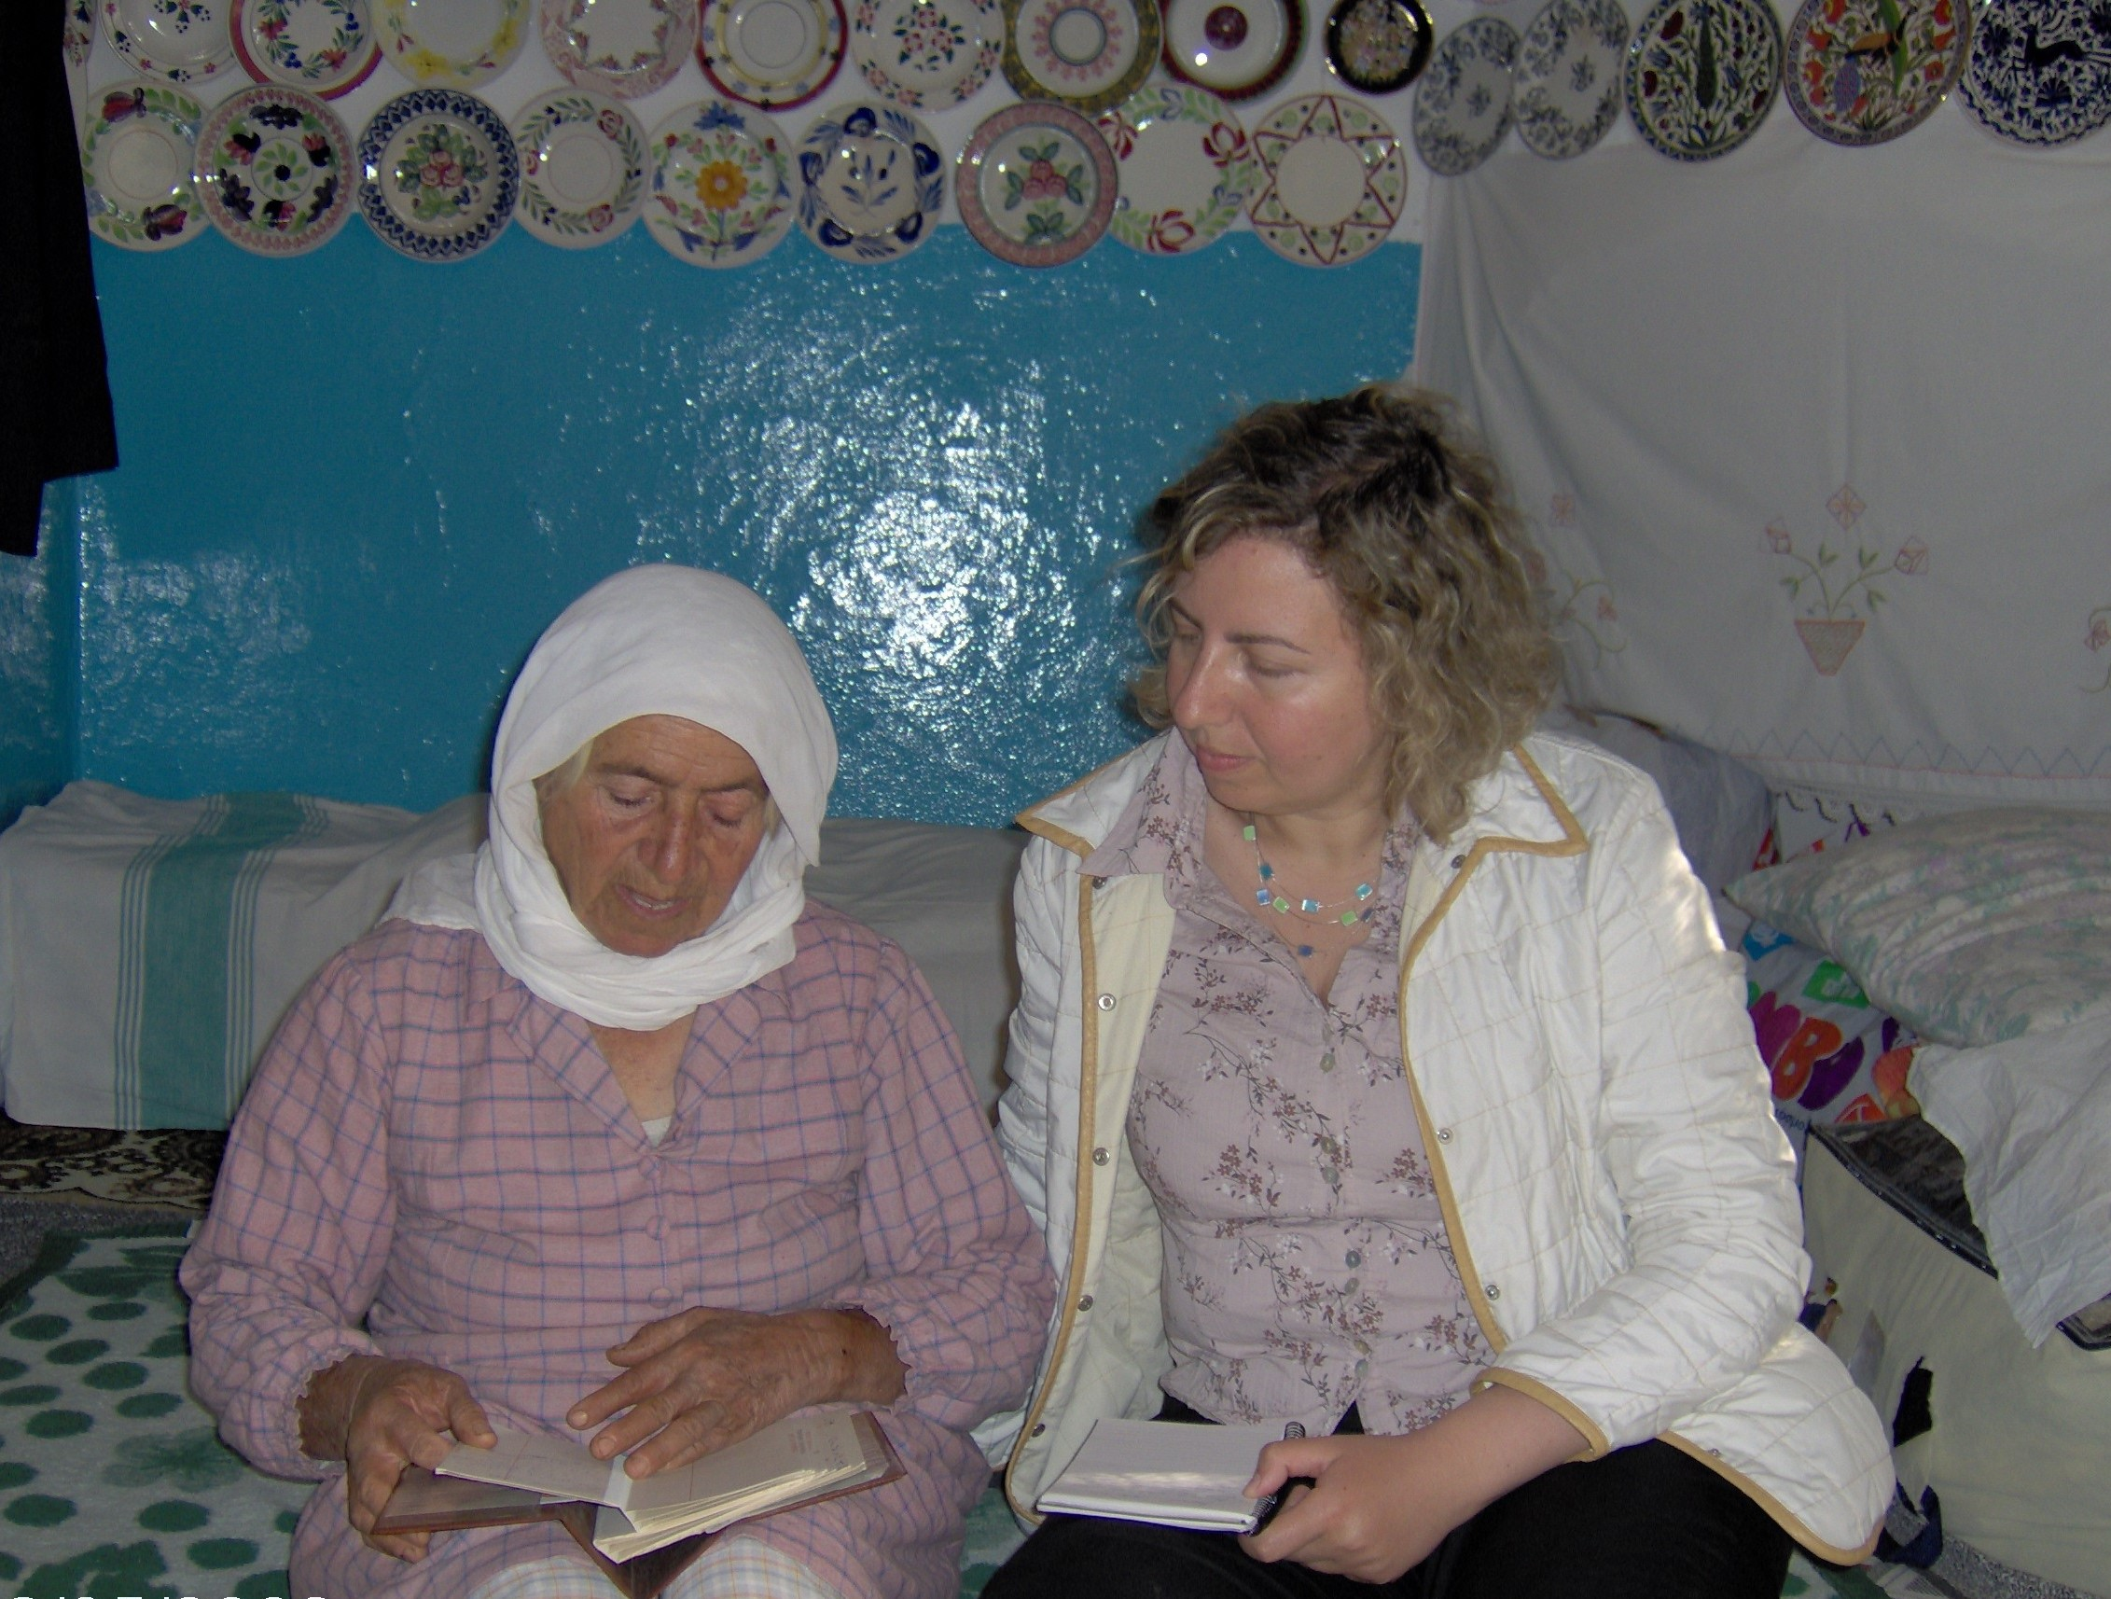
Marianthi Kaplanoglou, University of Athens
Associate Professor of Folklore Studies
Fields of Interest:
Social History of Folk Culture
Folk Narrative Genres
Comparative Folklore and Literature of
Southeastern Europe and the Mediterranean
Children’s folklore and Folklore in education
Recent book: Folktales and every-day life (in greek, Patakis Publications, 2022).
Stream 2: Narratives and Oral Traditions
(with Georgios Kouzas)

Slide 11
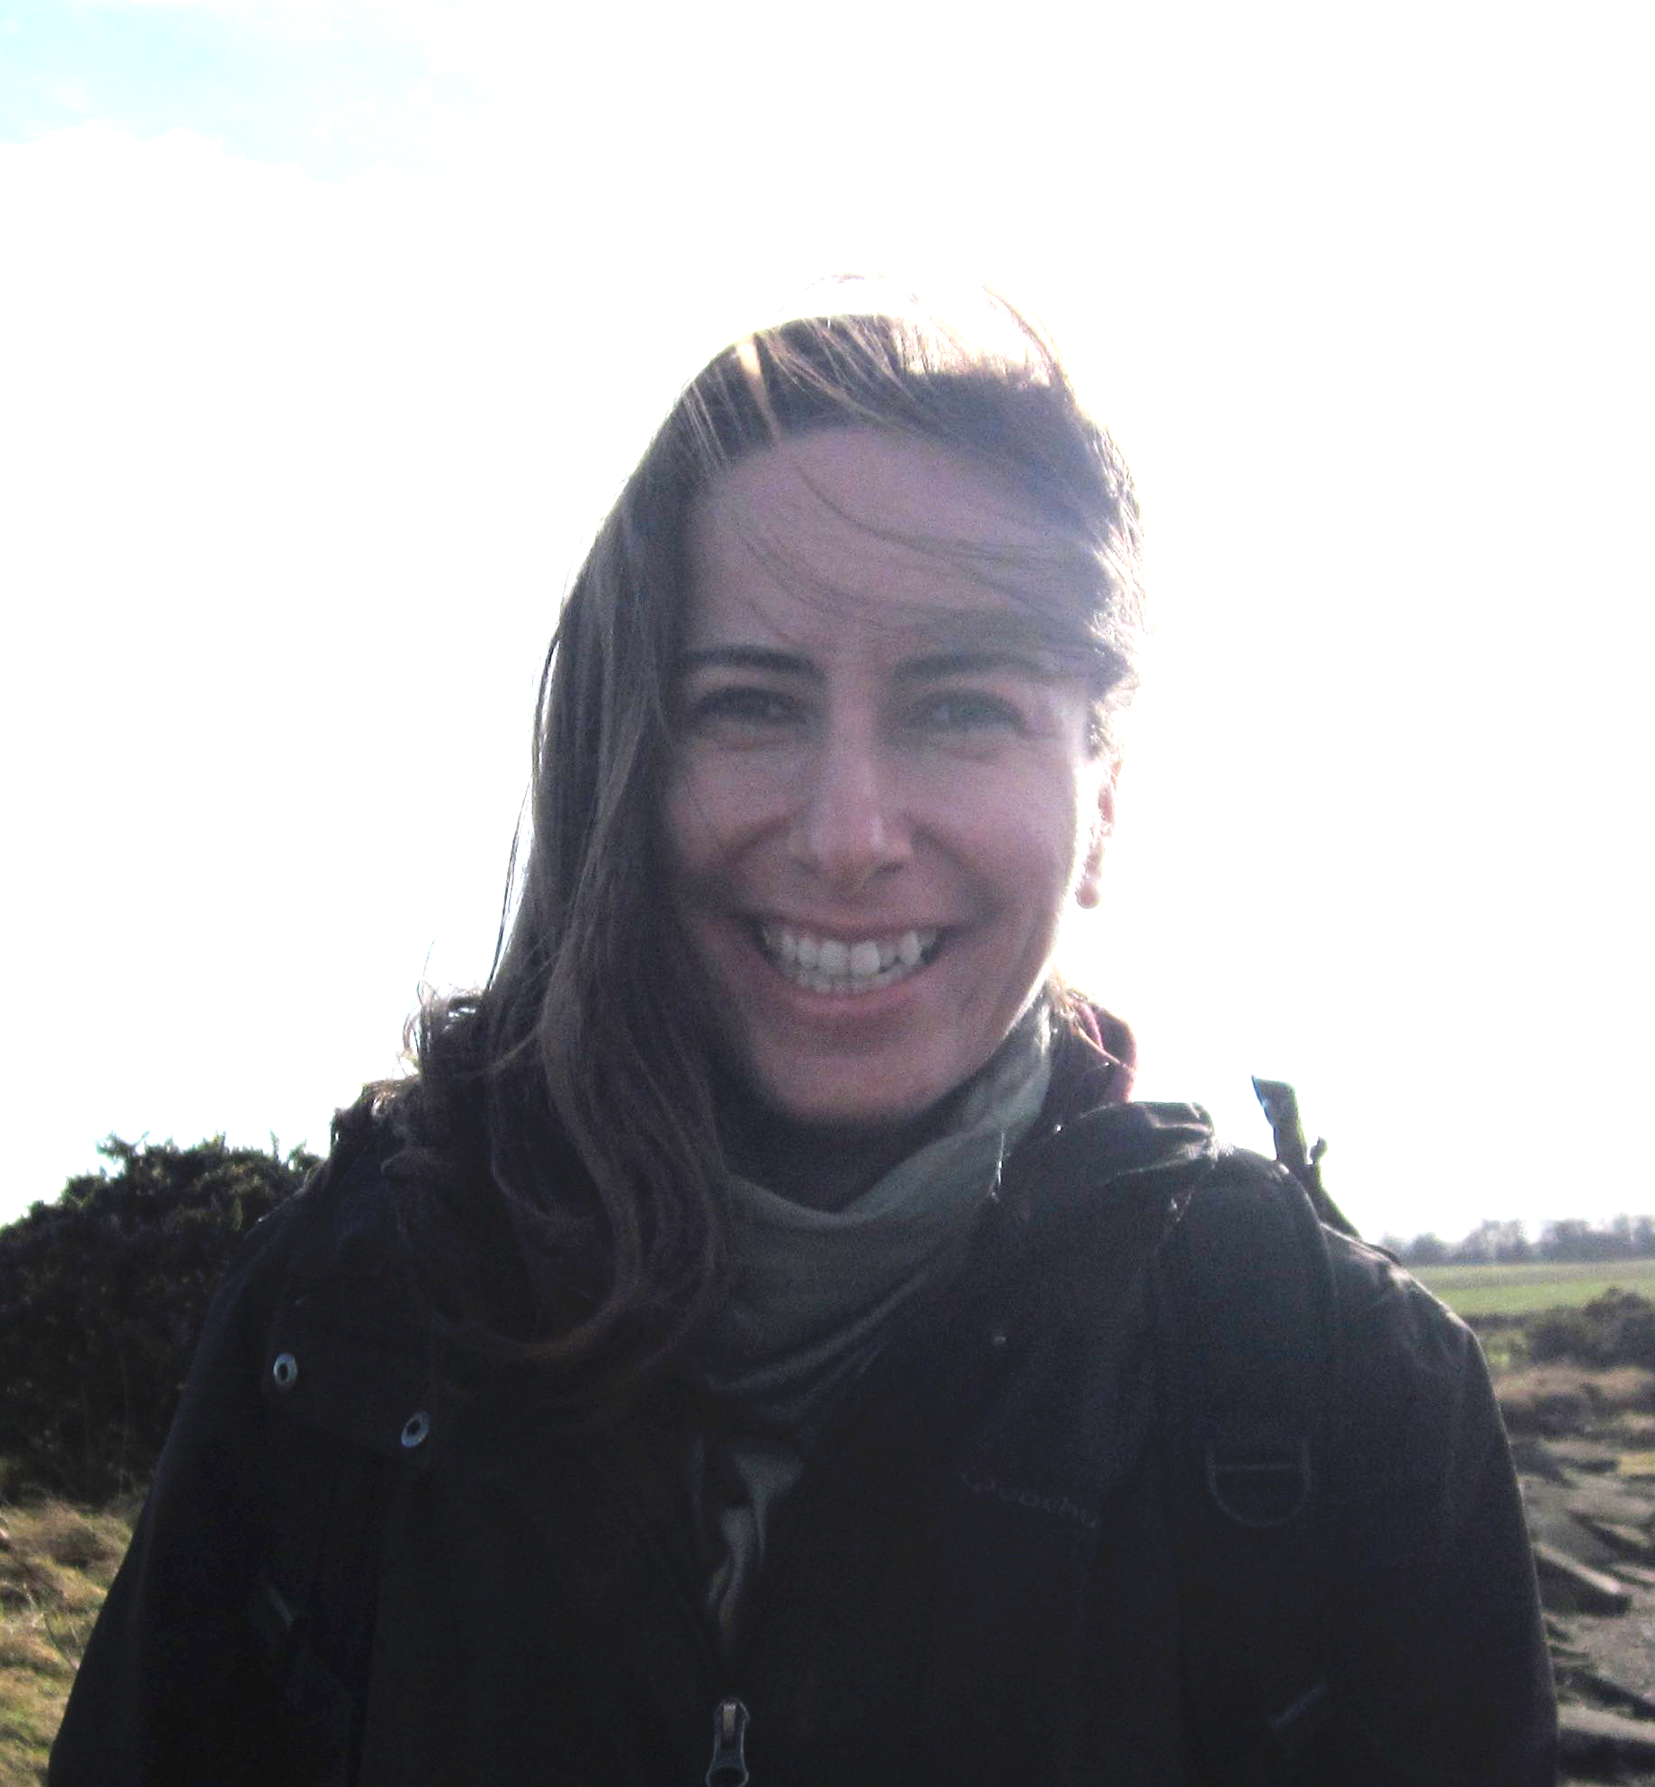
Claudia Campeanu, University of Bucharest
Associate Professor
Fields of Interest:
Environmental anthropology:
  Biological conservation and agricultural pratices
  Multispecies ethics
Migration, ethnicity
Tourism, heritage tourism
Eastern Europe, Romania
Stream 3: Material Culture and Ecology
(with Magda Craciun)

Slide 12
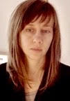
Magda Craciun, University of Bucharest
Lecturer in Anthropology
Fields of Interest:
Material Culture
Sustainability
Anthropology of Dress and Fashion
Anthropology of Middle Class
Public Anthropology
Eastern Europe & Turkey
Stream 3: Material Culture and Ecology
(with Claudia Campeanu)

Slide 13
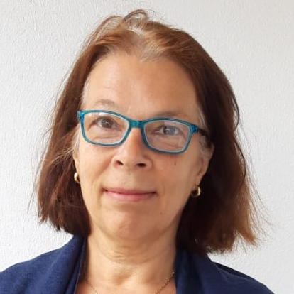

Gabriele Alex, University Tübingen
Professor of Social and Cultural Anthropology
Fields of Interest:
Medical Anthropology
Anthropology of Childhood
Museums in the 21st Century
Myths and Cosmological Histories
India, esp. South India
Stream 4: Material Culture and Identity
(with Sarah Holst Kjaer)

Slide 14
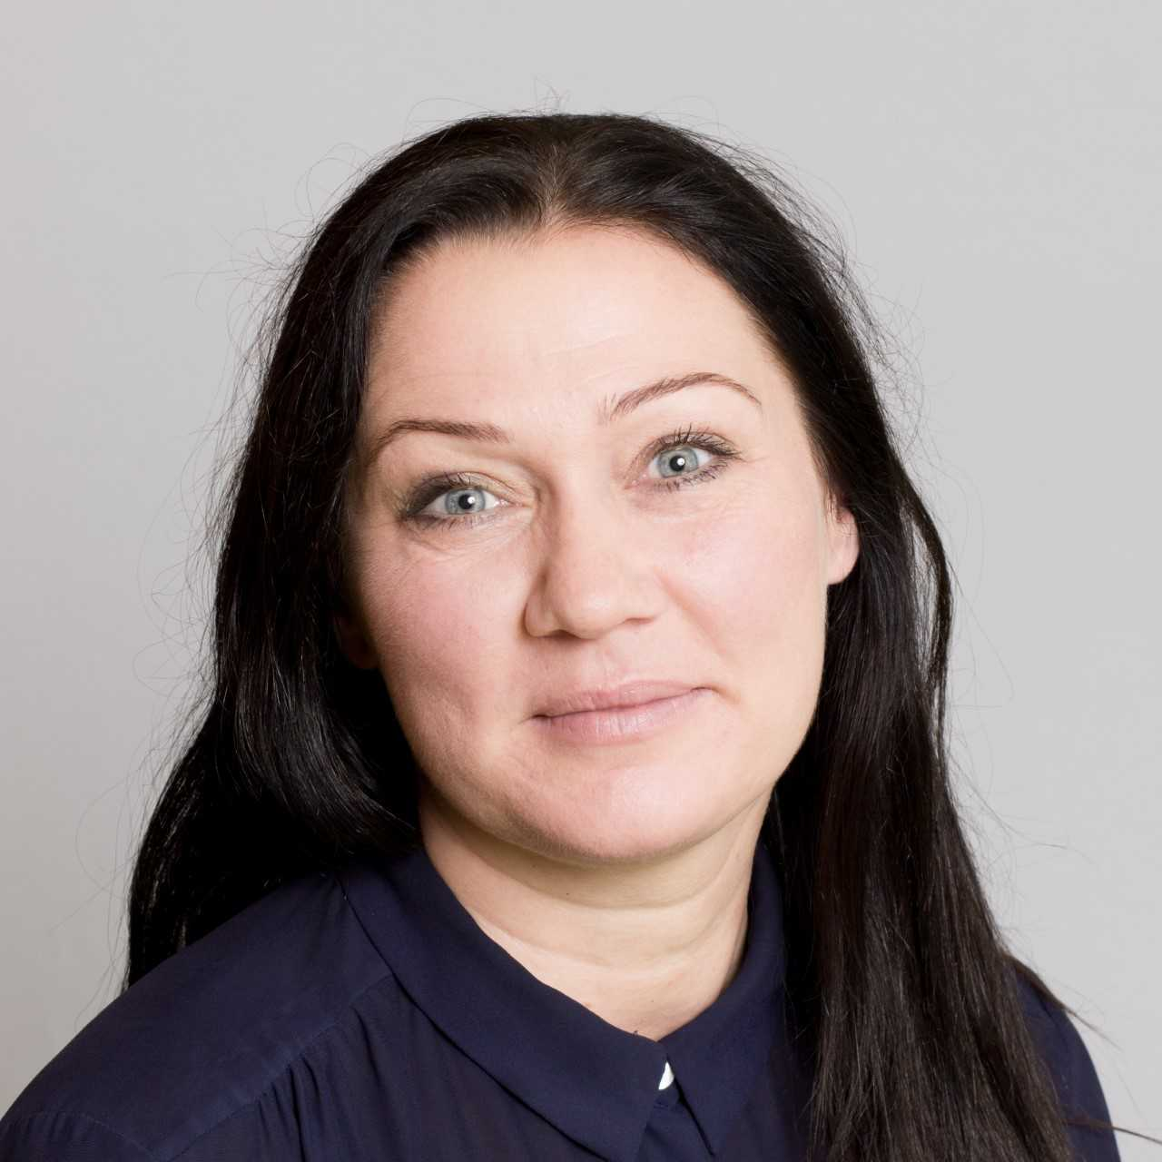

Sarah Holst Kjaer, Stockholm University
Associate Professor of Ethnology and Folklore
Fields of Interest:
Tourism and Experience Industry/Regional Development
Cities and Countrysides as Experience Scapes
Emotional Consumption/Love and Romantic Coupling
Home, Domestic Work and Couple‘s Leisure Life
Middle Class Cultural Fantasies about Succeeding in Life/Heteronormativity/Normality/Ways of belonging
The North, esp. Scandinavia
Stream 4: Material Culture and Identity (with Gabriele Alex)

Slide 15
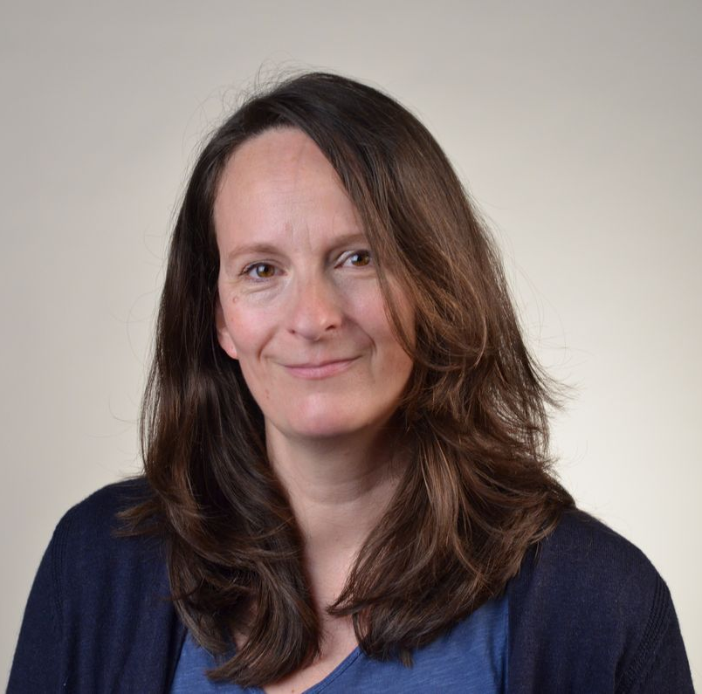
Karin Polit, University Tübingen
Professor of Social and Cultural Anthropology
Fields of Interest:
Global Hierarchy of Value, Circulation of Ideas, Goods, and
Aesthetics
Cultural Heritage, Rituals, and Religions
Education, Work, and Art in relation to Inequalities
Stress, Education, and Juvinille Suicide in India
Youth Culture in New Delhi
Supporting Staff and Speaker

Slide 16
Tyrus Torres, University Tübingen
Master’s Student of Ethnology/Social and Cultural Anthropology
Fields of Interest:
Homelessness, Poverty, Drug Abuse, and Addiction
Minorities and Minority Rights
Concepts of Masculinity and Shame
Social Agency in Urban Anthropology
Japanese Language and Culture
Student Assistant

Slide 17
What do we mean with “Going Public”
Not just work with and speak about communities, but also to actively engage with them, identify problems and work jointly on solutions.
Explore social and communal issues, what their impact is in the everyday life and experiences of people and communities.
How people think about these issues and respond to them and how they build communities around these issues.

Slide 18
What do we mean with “Going Public”
Increasing awareness of the interconnectedness of people and communities throughout the world. Important political, economic and social issues are understood as public issues affecting the entire world.
Shared knowledge, common and diverse practices applied by different individuals and societies, researched through comparative study.
People as active agents in society. How global issues influence personal identity at the local, regional, and national level and in everyday life. This can be seen in the ways in which people talk about themselves and their lives. Exploring individual narratives as part of everyday life and of artistic communication (storytelling). Looking at oral and digital narratives of traumatic experience provided by migrants, refugees and exiles, either as literature or as part of auto-ethnographies.

Slide 19
What do we mean with “Going Public”
Our world has become “smaller” through the diminishing of distance and the annihilation of time required for communication. The disciplines of anthropology, ethnology, folklore and sociology have developed new concepts, analytical tools and practices to approach their subjects of study in novel ways. They have become publicly oriented and engaged in public issues (Public Social Sciences). They are more connected with current social, political and ecological issues and more democratic, equitable and collaborative towards their subjects of study than they used to be. The social sciences are now reflexive, engaged, applied and public, drawing their theory consciously from involvement with the public and responding to its needs.

Slide 20
What do we mean with “Going Public”
Individuals and local communities orientate their activities and address their products so that they may be of relevance to the widest public, namely to a universal public. Our course looks at the interplay between local and global by focusing on matters of public concern such as material culture and ecology, and migration and refugee policies in different European and non-European societies.

Slide 21
Migration and Diversity
Led by: Vassiliki Chryssanthopoulou (Athens) & Adrian Stoicescu (Bucharest)
Migration, refugeeness, exile and diaspora constitute important public issues influencing societies and the social sciences and humanities alike in the 21st century. This stream explores these social phenomena and their impact upon the lives and identities of individuals, but also on the values, practices and strategies of communities, including states, and even alliances, such as the European Union. We look at social and cultural diversity in the context of migration in a comparative perspective. We try to interpret the differentiation of attitudes of empathy and inclusion, or exclusion and marginalization of the ‘other’ at an individual, group and state level. Have the refugee crises of this century led people to a more inclusive view of the world, or not? How have refugees and migrants themselves dealt with the challenges posed by their deterritorialized and fragmented lives? We examine transnational ways and strategies among diasporic individuals and communities. We look at their various ways of attempting to communicate their experiences of trauma and alienation, but also of resilience and a positive outlook on life, to their host societies, thus rendering them part of public history and the public sphere. We will explore some of the above questions in the following four sessions lasting 5 hours altogether:

Slide 22
Migration and Diversity
(Continued)
“Basic concepts, theories and research methods relating to migration and diversity” (by Vassiliki Chryssanthopoulou and Adrian Stoicescu, 16.05.2022, 14.00-16.00 UTC+2): Introduction to concepts and theoretical discussions on migration and to research methods to be pursued by the students to complete the exercises assigned to them during the period of their virtual instruction. These will include conducting interviews with migrants, refugees, individuals in exile or diasporic individuals; or, alternatively, they may be based on ethnographic observation in situ or in digital environments (for example, the study of websites etc.).
“From oral to digital narratives of traumatic experience: Memory, identity, and refugee heritage in the public sphere among a Greek ethno-regional diaspora in Australia” (by Vassiliki Chryssanthopoulou, 23.05.2022, 14.00-15.00 UTC+2): This lecture, based on the instructor’s multi-sited research, will explore a case study of post-World War II Greek refugees recreating their lives in Australia, redefining their collective myth and sense of heritage, and sharing it with the wider Australian public.

Slide 23
Migration and Diversity
(Continued)
“Digital diasporas” (by Adrian Stoicescu, 30.05.2022, 14.00-15.00 UTC+2).
“Auto-ethnographies of uprootedness: Examples from literature and oral history” (by V. Chryssanthopoulou and A. Stoicescu, 06.06.2022, 14.00-15.00 UTC+2): A comparison of auto-ethnographic narratives to draw on similarities and differences of representation in literature and in oral narratives of personal experience. We will examine how migrant and refugee authors-narrators talk about their personal experiences and identities (local, regional, national, transnational, global) as they attempt to communicate them widely, thus influencing public perceptions, understandings and action relating to migration and refugees.
In Tübingen, we will discuss the students’ projects in class and carry out some field visits and/or groupwork. Students will present, discuss and compare their findings thus attempting to reach a deeper understanding of diversity and the creation of new identities brought about by migration and the condition of refugeeness.

Slide 24
Narratives and Oral Traditions
Led by: Georgios Kouzas (Athens) & Marianthi Kaplanoglou (Athens)
Introduces issues of human rights, equality, peace, sustainability, and wellbeing.
How the fragile oral diverse traditions, nested in communities are to be safeguarded against the juggernaut of industrialized culture? (Bauman and Briggs 2003: 308)
The political standpoint (traditionalization - politics of culture): Transformation of social practices and performances into representations appropriated into discourses on heritage and its technical productions: conception of folklore as a collection of things or formulated ideas, folklore as vanishing object, which needs for documentation, protection and display - political value of the created text, interventions by experts, enabled by Unesco Member States (national archives, documentation centers, museums).

Slide 25
Narratives and Oral Traditions
(Continued)
Result: Freezing of cultural forms, historicizing process (Bausinger 1990: 82), emphasis on traditions as cultural properties (Anttonen 2005: 39).
The scientific standpoint (Folklore studies): The activity of a folklorist is to record in order to analyze and interpret, not to preserve and display. Folklore is not an aggregation of things but a dynamic communicative process (Ben-Amos 1972: 9). Orientation of folklore studies towards the social function of folklore in situated practices – scholarly focus on singers and narrators as individual performers and as members of social groups and their interplay in everyday life. Oral traditions are open-ended processes shaped by the inter-play between individually generated variations on the one hand, and selection criteria upheld by historically changing communities on the other (Vaz da Silva 2012: 51).

Slide 26
Narratives and Oral Traditions
Orality and everyday life: From public to private life and vice versa
Result: Methodologically, putting the “folk” back into “folklore”. Study of folklore as a shared culture ( multifaceted relationship between the individual and the collectivity – STUDY OF VARIATION).
THE FOLKLORE ARCHIVE - THE HISTORICAL ARCHIVE
The relationship between public space and private.
The interaction of public and private in everyday discussions (Rumors, Gossip, urban legends, conspiracy theories).
The importance of public space (and especially the street) for the culture of everyday life.

Slide 27
Narratives and Oral Traditions
(Continued)
Oral speech and emotions from public to private life
Contemporary folklore research especially focuses on how the issue of both public and private life, and how public events (even in the micro-level of the neighborhood or the macro-level of the city or the country where we live) pass to the private area through social comments, i.e. daily gossip.
However, apart from the dissemination of information, modern folklorists focus on the dynamic presence of the emotions that accompany social comments. The judgments and comments of people are accompanied by emotions, either positive towards some people, which in essence promote persons or situations in a positive way, or expressing negative emotions, which accompany negative judgments and in essence judge and control the behaviors of people.

Slide 28
Material Culture and Ecology: Topics in Public Anthropology
Led by: Claudia Câmpeanu & Magda Crăciun (Bucharest)
Public anthropology
Engaged/activist anthropology
Applied anthropology
Participatory action research
Anthropology for and with a wider public
Current problems:
Climate change
Pollution
Biodiversity loss
Learning outcomes:
At the end of the course, students should be able to:
Explain the meaning, scope, and relevance of public anthropology
Describe specific methodologies used in public anthropology
Write a public anthropology text
Evaluate a public anthropology text
Schedule:
(all times are Bucharest times)
M1: 19 May 12 – 1pm. Introduction to Public anthropology (1h)
M2: 20 May 12 – 1pm. Dissemination Methods (1h)
M3: 31 May 12 – 2pm. Engaging with the wider public: Examples (2h)
  June 14 Deadline for uploading the exercise
  June 14-21 Peer review
M4: 21 June 12 – 1pm. Feedback and Discussion (1h)

Slide 29
Material Culture and Identity
Led by: Gabriele Alex (Tübingen) & Sarah Holst Kjaer (Stockholm)
Links between materiality/material culture and identity.
How do people relate to the world around them, such as the urban landscape, monuments, the lived-in environments, but also with objects and materialities that frame our everyday life with different functions and in different ways.
Comparative perspectives, constructions of identity, belonging, marginalization or exclusion.
Lectures, texts, student group-work on the practice of ethnographical methods.
One individual student exercise while still being at their home universities.
In Tübingen: Excursion to the Lindenmuseum (museum-focused perspective).
Student examination: Group presentation and discussion on how ethnographical practice can support e.g. community-building or inclusion processes.

Slide 30
Organisational Matters
Venue
Tübingen in June
Assistance in Tübingen
Tyrus Torres
Contact with German Students

Slide 31
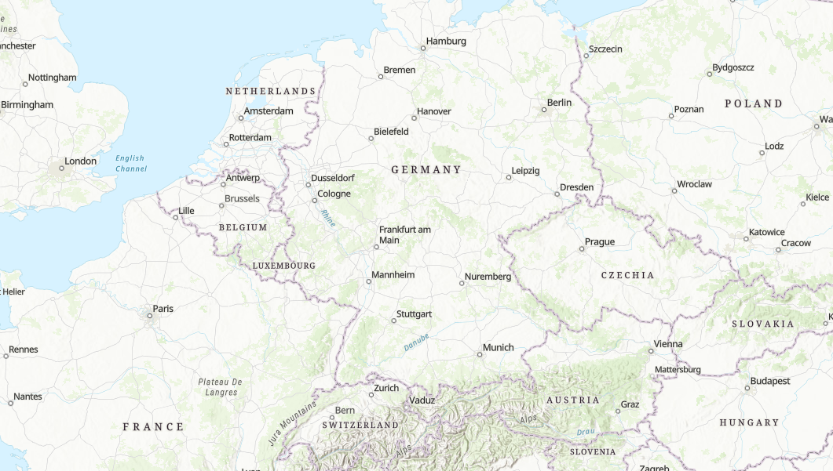
Where is Tuebingen?

Slide 32
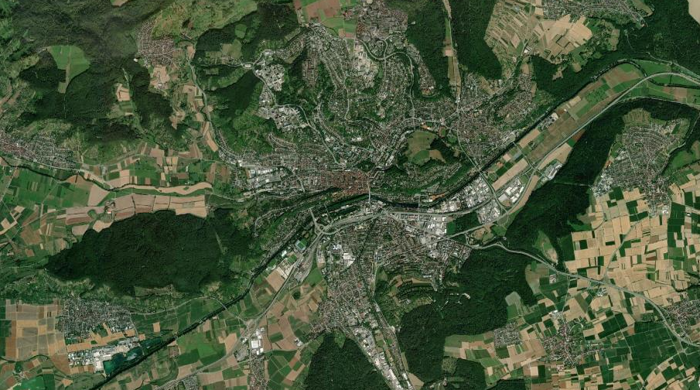
Tuebingen along the Neckar River

Slide 33
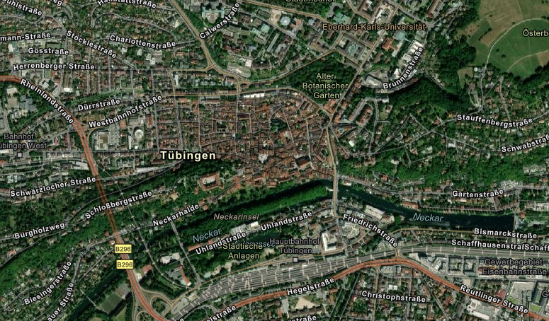
Tuebingen Upclose
12 minute walk

Slide 34
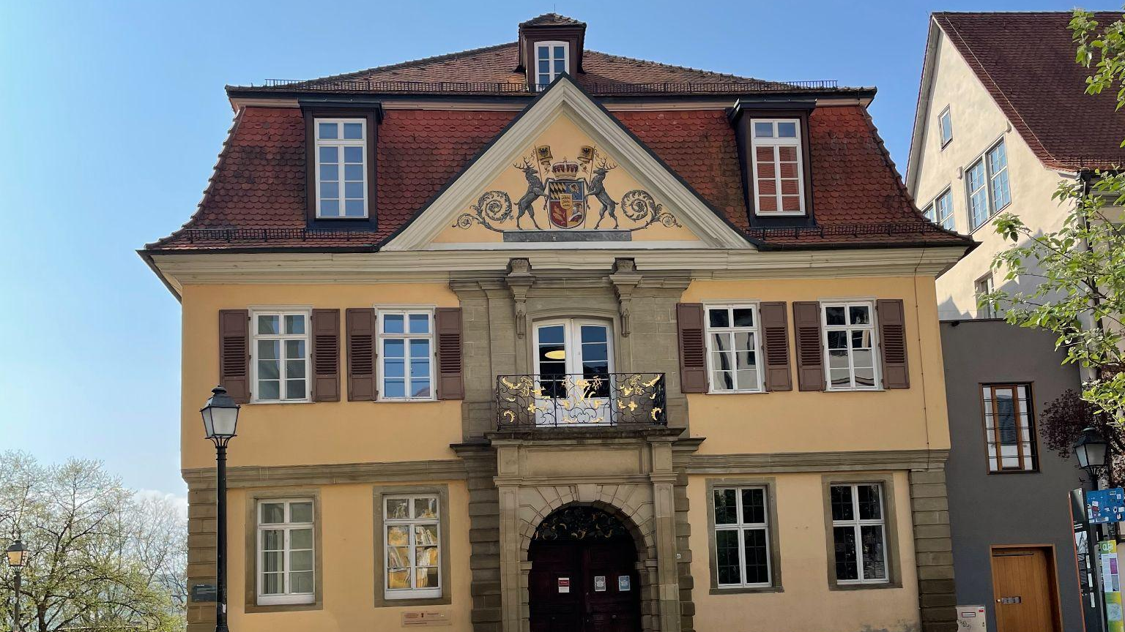
Tübingen - University Building

Slide 35
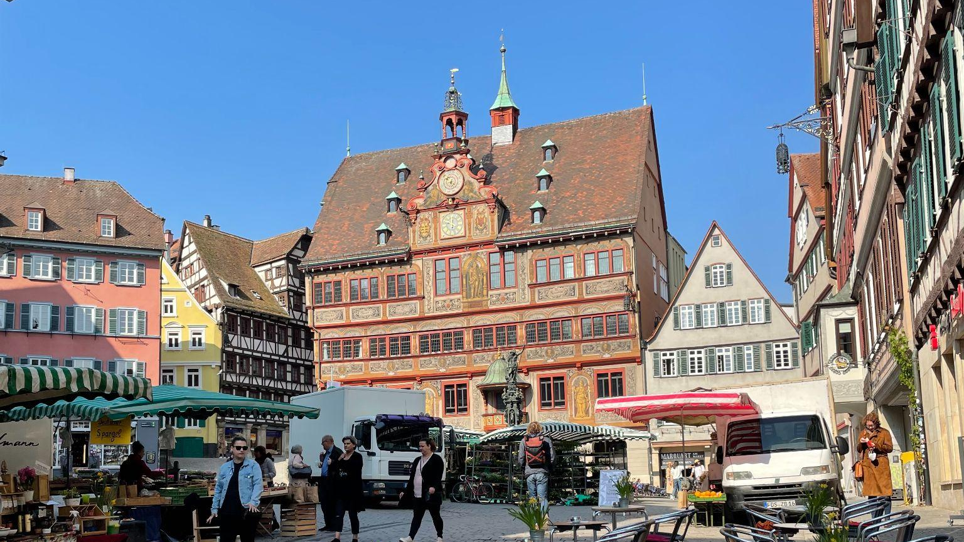
Tübingen - Town Hall

Slide 36
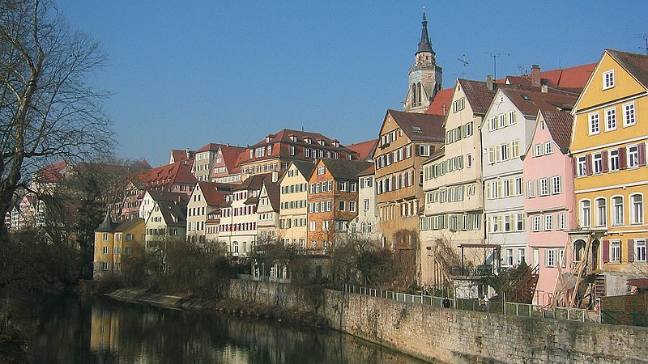
Tübingen - River

Slide 37
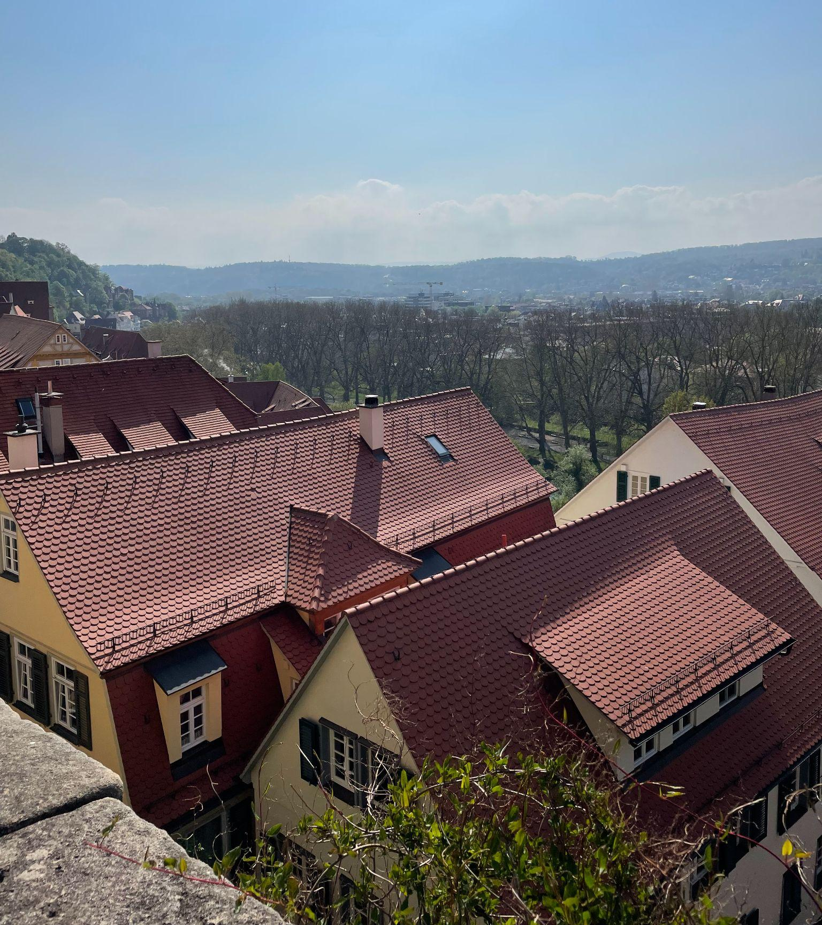
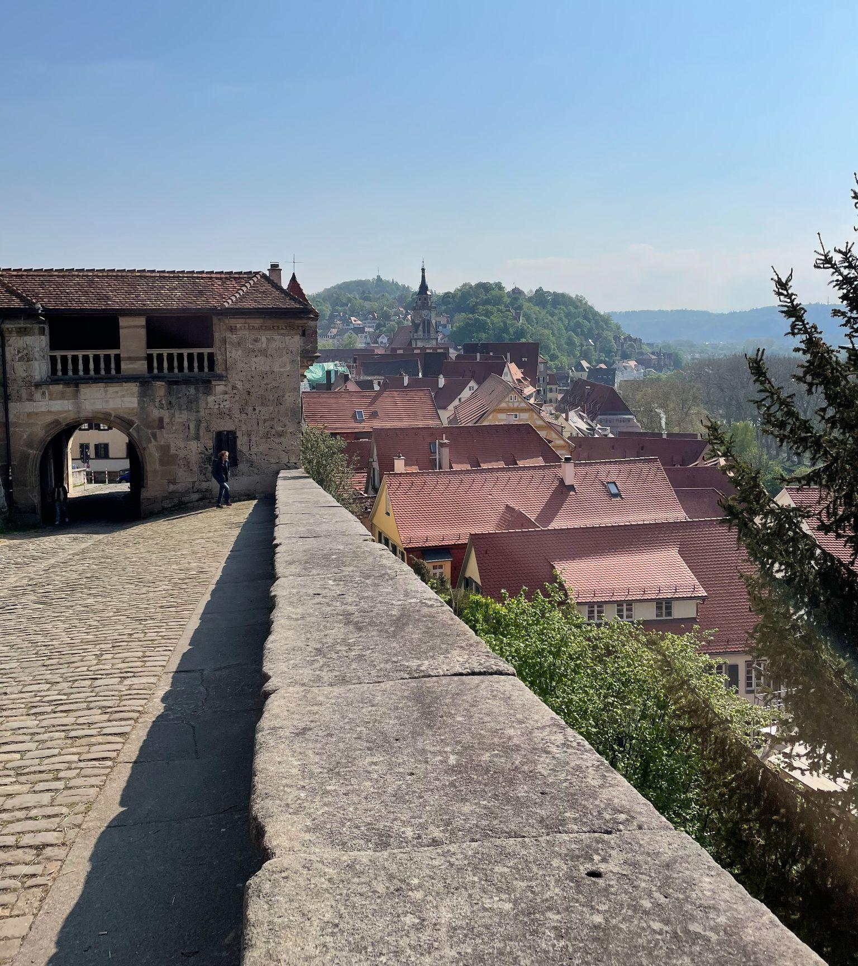
Tübingen - View from Castle

Slide 38
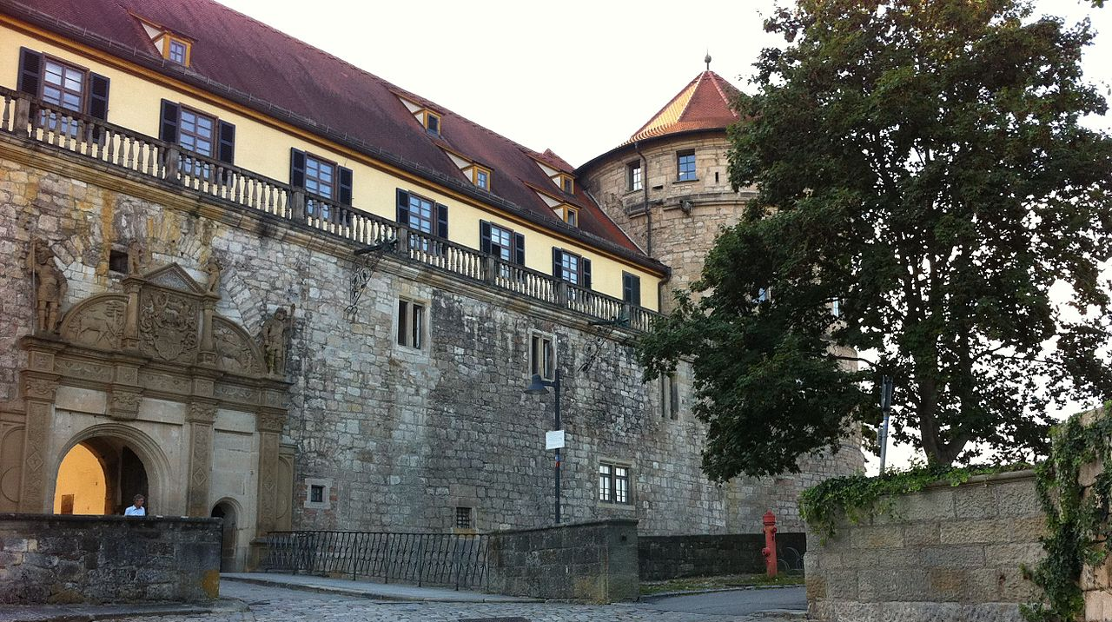
Tübingen - University Castle

Slide 39
Questions?

