Slide 1

Going public: Social sciences and Humanities in the 21st century in Europe
Explore the potentials and challenges of ‘going public’ in several connected disciplines – anthropology, ethnography, literary studies, and folklore studies – in response to the social, political and ecological issues facing societies and collectives in the diversified Europe of the 21st century
Civis Hub 2: Society, Culture, Heritage
13.05.2022
Stream 1
Migration and diversity
Vassiliki Chryssanthopoulou
Adrian Stoicescu
Source: https://europeanmovement.eu/event/emi-migration-event-series-tackling-the-root-causes-of-migration/

Slide 2

Structure of the presentation
Let’s start with the recent numbers
Types of mobility
Approaches to migration studies
Identity issues
Questions to answer
References

Slide 3
Let’s start with the recent numbers (1)
Source: UN Department of Economic and Social Affairs

Slide 4
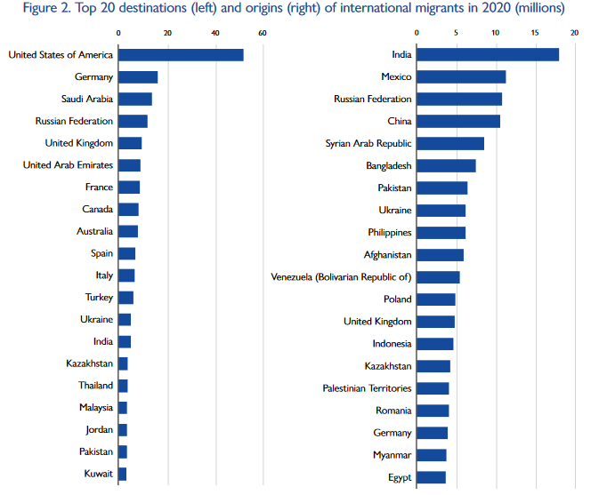
Let’s start with the recent numbers (2)
Source: UN Department of Economic and Social Affairs

Slide 5
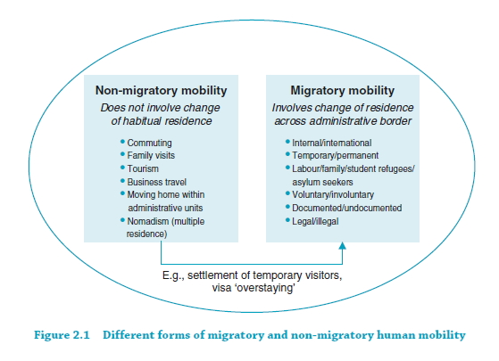
Types of mobility
Source: de Haas, Castels and Miller (2020 [1993]): 22

Slide 6
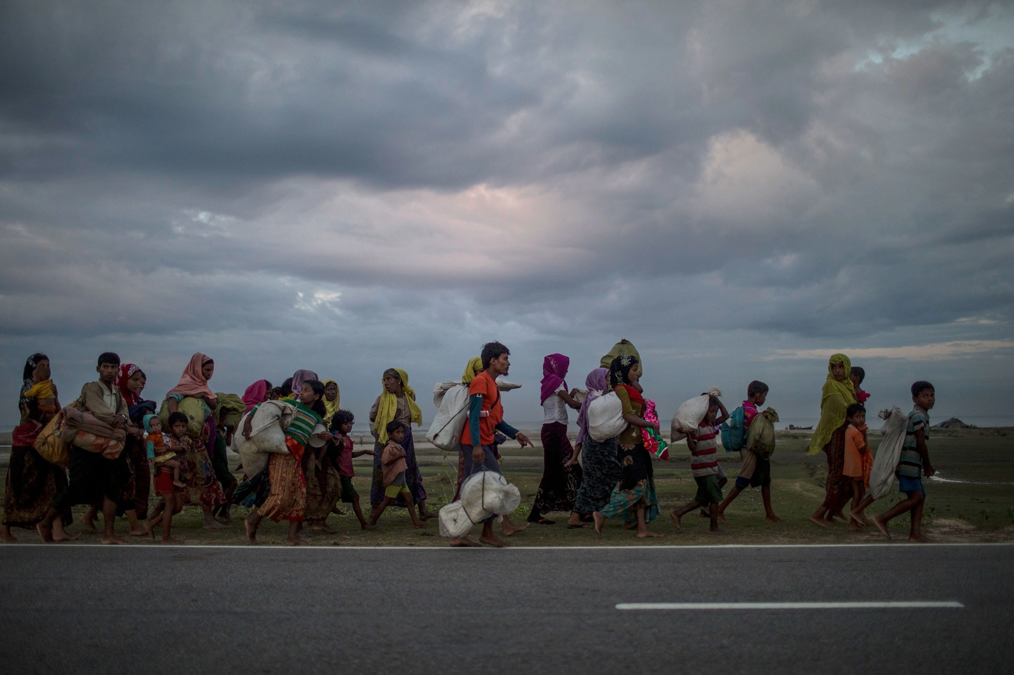
Approaches to migration studies
One broad division separates those social scientists who take a top- down “macro” approach, focusing on immigration policy or market forces, from those whose approach is bottom-up, emphasizing the experiences of the individual migrant or the immigrant family.
(Brettel & Hollifield 2015 [2000]: 2)
Who looks at the migrant?
Historians
Sociologists
Anthropologists
Political scientists
Demographers
Geographers
Economists
Legal scholars
Source: https://www.nationalgeographic.com/culture/article/migration

Slide 7
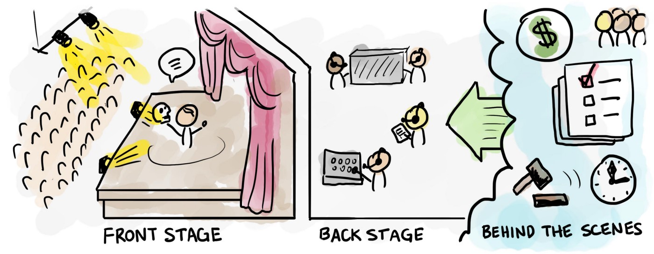
Identity issues (1)
Front stage performance (performing identity dramaturgically): social interaction as a dialogue between two teams
A social establishment is any place surrounded by fixed barriers to perception in which a particular kind of activity regularly takes place. I have suggested that any social es­tablishment may be studied profitably from the point of view of impression management. Within the walls of a social establishment we find a team of performers who co­operate to present to an audience a given definition of the situation. This will include the conception of own team and of audience and assumptions concerning the ethos that is to be maintained by rules of politeness and decorum. We often find a division into back region, where the perform­ance of a routine is prepared, and front region, where the performance is presented. Access to these regions is con­trolled in order to prevent the audience from seeing back- stage and to prevent outsiders from coming into a perform­ance that is not addressed to them. Among members of the team we find that familiarity prevails, solidarity is likely to develop, and that secrets that could give the show away are shared and kept. A tacit agreement is maintained be­tween performers and audience to act as if a given degree of opposition and of accord existed between them.
(Goffman 1959: 238)
Source: https://blog.practicalservicedesign.com/the-difference-between-a-journey-map-and-a-service-blueprint-31a6e24c4a6c

Slide 8
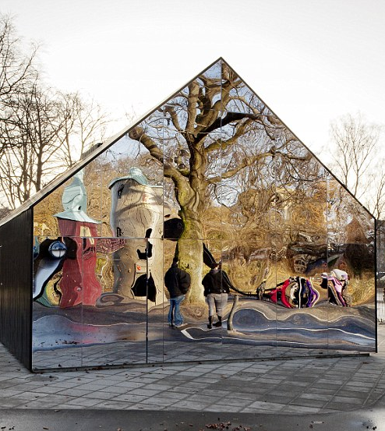
Identity issues (2)
Sliding away from the front stage performance
[…] I will try to show some ways in which reified and naturalized conceptions of gender [and we most certainly may add, of identity in general, our addition] might be understood as constituted and, hence, capable of being constituted differently. In opposition to theatrical or phenomenological models which take the gendered self to be prior to its acts, I will understand constituting acts not only as constituting the identity of the actor, but as constituting that identity as a compelling illusion, an object of belief. (Butler 1998: 520)
Distinction between expression and performativeness
Source: https://www.dailymail.co.uk/news/article-2091052/A-reflection-society-Eye-catching-building-uses-mirrors-deter-graffiti-artists.html

Slide 9

Identity issues (3): I am who I am!
Decision to leave – failure to conform to the front stage identity performance
- embodying expression rather than performativeness
Causes of failure – odd one out complex stemming from various reasons
Source: https://www.dailymail.co.uk/news/article-2091052/A-reflection-society-Eye-catching-building-uses-mirrors-deter-graffiti-artists.html

Slide 10
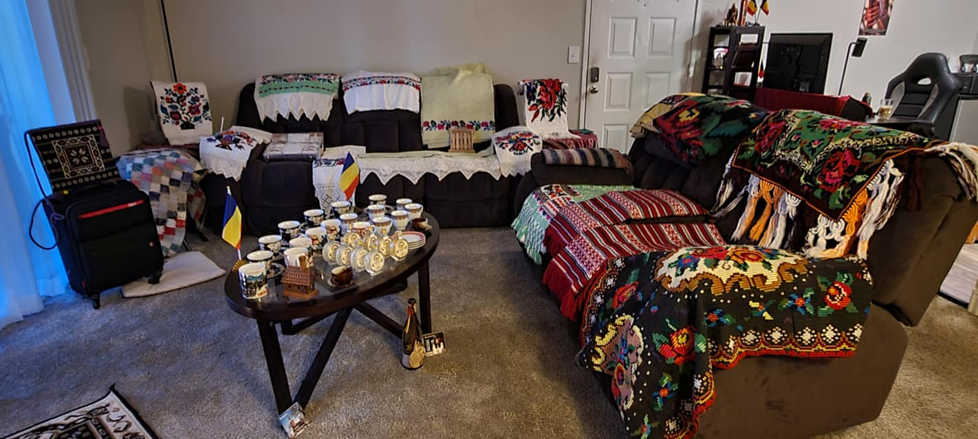
Identity issues (4): Omnia mea mecum porto
Struggle to adopt or adapt – embracing front stage identity, but also retaining homeness
- a homier home than the back home home?
Everything I might have had I carry with me
Izidor Ruckel

Slide 11

The construction of migrant and refugee identity from an anthropological perspective: On ‘boundaries’ and ‘symbols’ in forging community and identity
Identity issues (5)
By definition, the boundary marks the beginning and end of a community. But why is such marking necessary? The simple answer is that the boundary encapsulates the identity of the community and, like the identity of an individual, is called into being by the exigencies of social interaction. Boundaries are marked because communities interact in some way or other with entities from which they are, or wish to be, distinguished (see Barth, 1969). […] But not all boundaries, and not all the components of any boundary, are so objectively apparent. They may be thought of, rather, as existing in the minds of their beholders. This being so, the boundary may be perceived in rather different terms, not only by people on opposite sides of it, but also by people on the same side. We are talking here about what the boundary means to people, or, more precisely, about the meanings they give to it. This is the symbolic aspect of community boundary …
[Several social categories] are variable in meaning. In some cases, the content of the categories is so unclear that they exist largely on only in terms of their symbolic boundaries. Such categories as justice, goodness, patriotism, duty, love, peace, are almost impossible to spell out with precision. But their range of meanings can be glossed over in a commonly accepted symbol – precisely because it allows its adherents to attach their own meanings to it. They share the symbol, but do not necessarily share its meanings. Community is just such a boundary-expressing symbol.
(Source: Anthony P. Cohen, The Symbolic Construction of Community, 1985, pp. 12, 15).

Slide 12
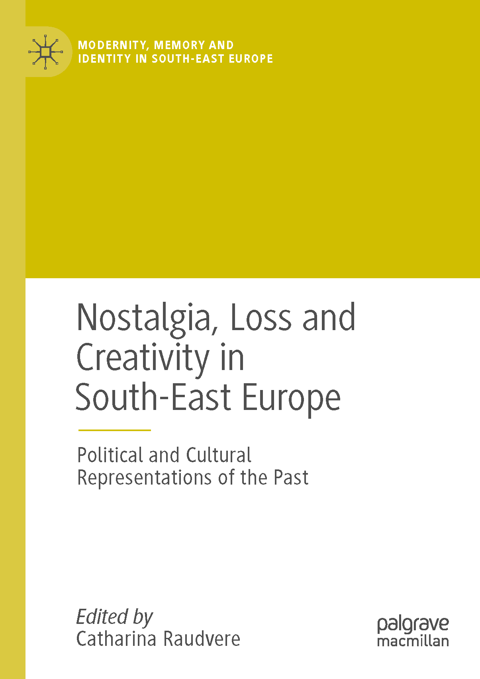
Nostalgia examined
Identity issues (6)
I suggest that the nostalgia produced by forced displacement is more fundamental because it entails the disruption of the self, of the matrix of identity, of the social fabric to which one belongs, and thus of the whole person. My interpretation rests on the assumption that forced displacement of any kind disrupts the whole person. The key to my argument is that personhood and place are indissolubly bound up together in most societies. I am pursuing an understanding which is not confined to literate, urban or bourgeois cultural groups. Consequently, our conceptual framework for understanding must be wide enough to encompass the varied expressions of the relationship between person and place in different societies. This is particularly important under current circumstances where natural disasters and climate change are contributing to widespread displacement (McAdam 2012).
It is vital to emphasize that in many parts of the world the notions of the human subject and of place are inextricably linked and integrated conceptually. They differ greatly in content from those which characterize the world of modernity - the capitalist industrial world which tends towards fragmentation, where power and wealth reside, and where international conventions and the development of human rights regimes are formulated. The ways in which the relationship between personhood and place is formed have varied expressions in different cultures. Despite the great inroads made everywhere by the global economy, and despite the claims of the transnationalists that we have entered an era of deterritorialization, these culturally specific notions regarding spatial relations are still salient.
(Source: Renée Hirschon, “Enduring Bonds of Place: Personhood and the Loss of Home”, in Catharine Raudvere (ed.), Nostalgia, Loss and Creativity in South-East Europe, Palgrave Macmillan 2018, p. 220).

Slide 13
Towards expanding our understanding
Identity issues (7)
As we have seen, mass population displacement, most likely of an irreversible kind, is increasing. The causes of forced displacement are many and various, and in the contemporary world enormous challenges are posed for human beings all over the planet. These problems will not be resolved rapidly or easily. It is my view that dislocation of any kind disrupts the very basis of personhood through removing the structures and content of the known and familiar world. Downing’s concept of social geometry makes sense of the disorientation experienced by people who are forcibly removed from their homes, even when communities are reconstituted in planned developments. It is this radical disjunction of people from their place of origin, their home, together with the notion of personhood which helps account for the pervasive phenomenon of persistent long-term nostalgia and yearning for home. Far from being whimsical romanticism, I argue that long-term attachment to place is grounded in the human life cycle; though subject to a great variety of expressions, it nonetheless reflects a universal human nexus of belonging.
Taking an anthropological viewpoint is not easy: it is challenging to grasp a different worldview, another ‘moral order’, partly because it is invisible to us or seems irrational. It is also very difficult because it involves becoming critically aware of our own culturally embedded assumptions. At the present time of crisis, with mass population displacements (whether through conflict, development schemes, climate change or for economic reasons), it is necessary to abandon the pervasive hegemony of western thought. In order to react appropriately to these contemporary demographic upheavals, we need to exercise empathy and imagine ourselves into the perceptions of people whose thinking about their place on this planet is rather different from our own. We are called upon to enter imaginatively into the degree of disruption experienced by individuals removed from the place where these relationships are the essence of being.
My aim in this chapter is to broaden the scope for understanding the cultural variety in responses to displacement, and it attempts to account for the enduring and pervasive longing for home which is such a significant factor in the experience of displacement. I hope that this effort might improve our ability to deal compassionately and adequately with those who face long-term exile from their homes.
(Source: Renée Hirschon, “Enduring Bonds of Place: Personhood and the Loss of Home”, in Catharine Raudvere (ed.), Nostalgia, Loss and Creativity in South-East Europe, Palgrave Macmillan 2018, p. 231).

Slide 14
Questions to answer during the next meetings:
How would we research this difference of identity building and how (if any) such paradoxes manifest themselves in different types of displacement.
What kinds of practices would the researcher observe? In what social contexts would the researchers like to accompany the migrant so that they can notice such negotiation of his/her identity?
Are there any objects that might become meaningful in the process of identity making?
Ηow do migrants remember home? How do they recreate home in the host society?
What happens with the (diverse) identities of the second generation of migrants? What are the factors influencing these identities?
Migrants and refugees: similarities and differences regarding their personal and collective identities.
What are the challenges/difficulties and the benefits of employing an anthropological approach to the study of human cultures and identities?
Source: https://www.dailymail.co.uk/news/article-2091052/A-reflection-society-Eye-catching-building-uses-mirrors-deter-graffiti-artists.html

Slide 15
References:
Brettel, Caroline B. & Hollifield, James F. (eds.) (2015 [2000]), Migration Theories. Talking across Disciplines. Routledge.
Butler, Judit (1998), ‘Performative Acts and Gender Constitution: An Essay in Phenomenology and Feminist Theory’, in Theatre Journal, Vol. 40, No. 4, pp. 519-531.
Cohen, Anthony P. (1985), The Symbolic Construction of Community, Εllis Horwood Ltd, Tavistock Publications.
de Haas, Hein, Castels Stephen & Miller Mark. J (2020 [1993]), The Age of Migration. International Population Movements in the Modern Worlds, MacMillan
Hirschon, Renée (2018), “Enduring Bonds of Place: Personhood and the Loss of Home”, in Catharine Raudvere (ed.), Nostalgia, Loss and Creativity in South-East Europe, Palgrave Macmillan 2018, pp. 213-236
Goffman, Erwin (1959), The Presentation of the Self in Every Day Life, Anchor Books.

