Slide 1
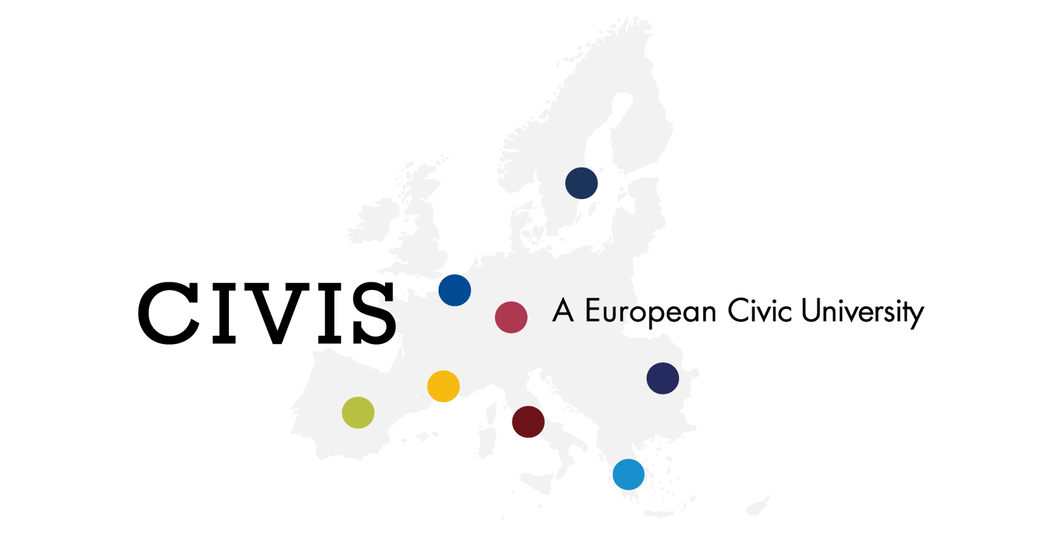
Going Public: Social Sciences and
Humanities in the 21st century in Europe
Students:
Andreea-Maria Stănescu
Mirela Petrică
Simona Elena Ion
Smaranda Andreea Stoica

Slide 2
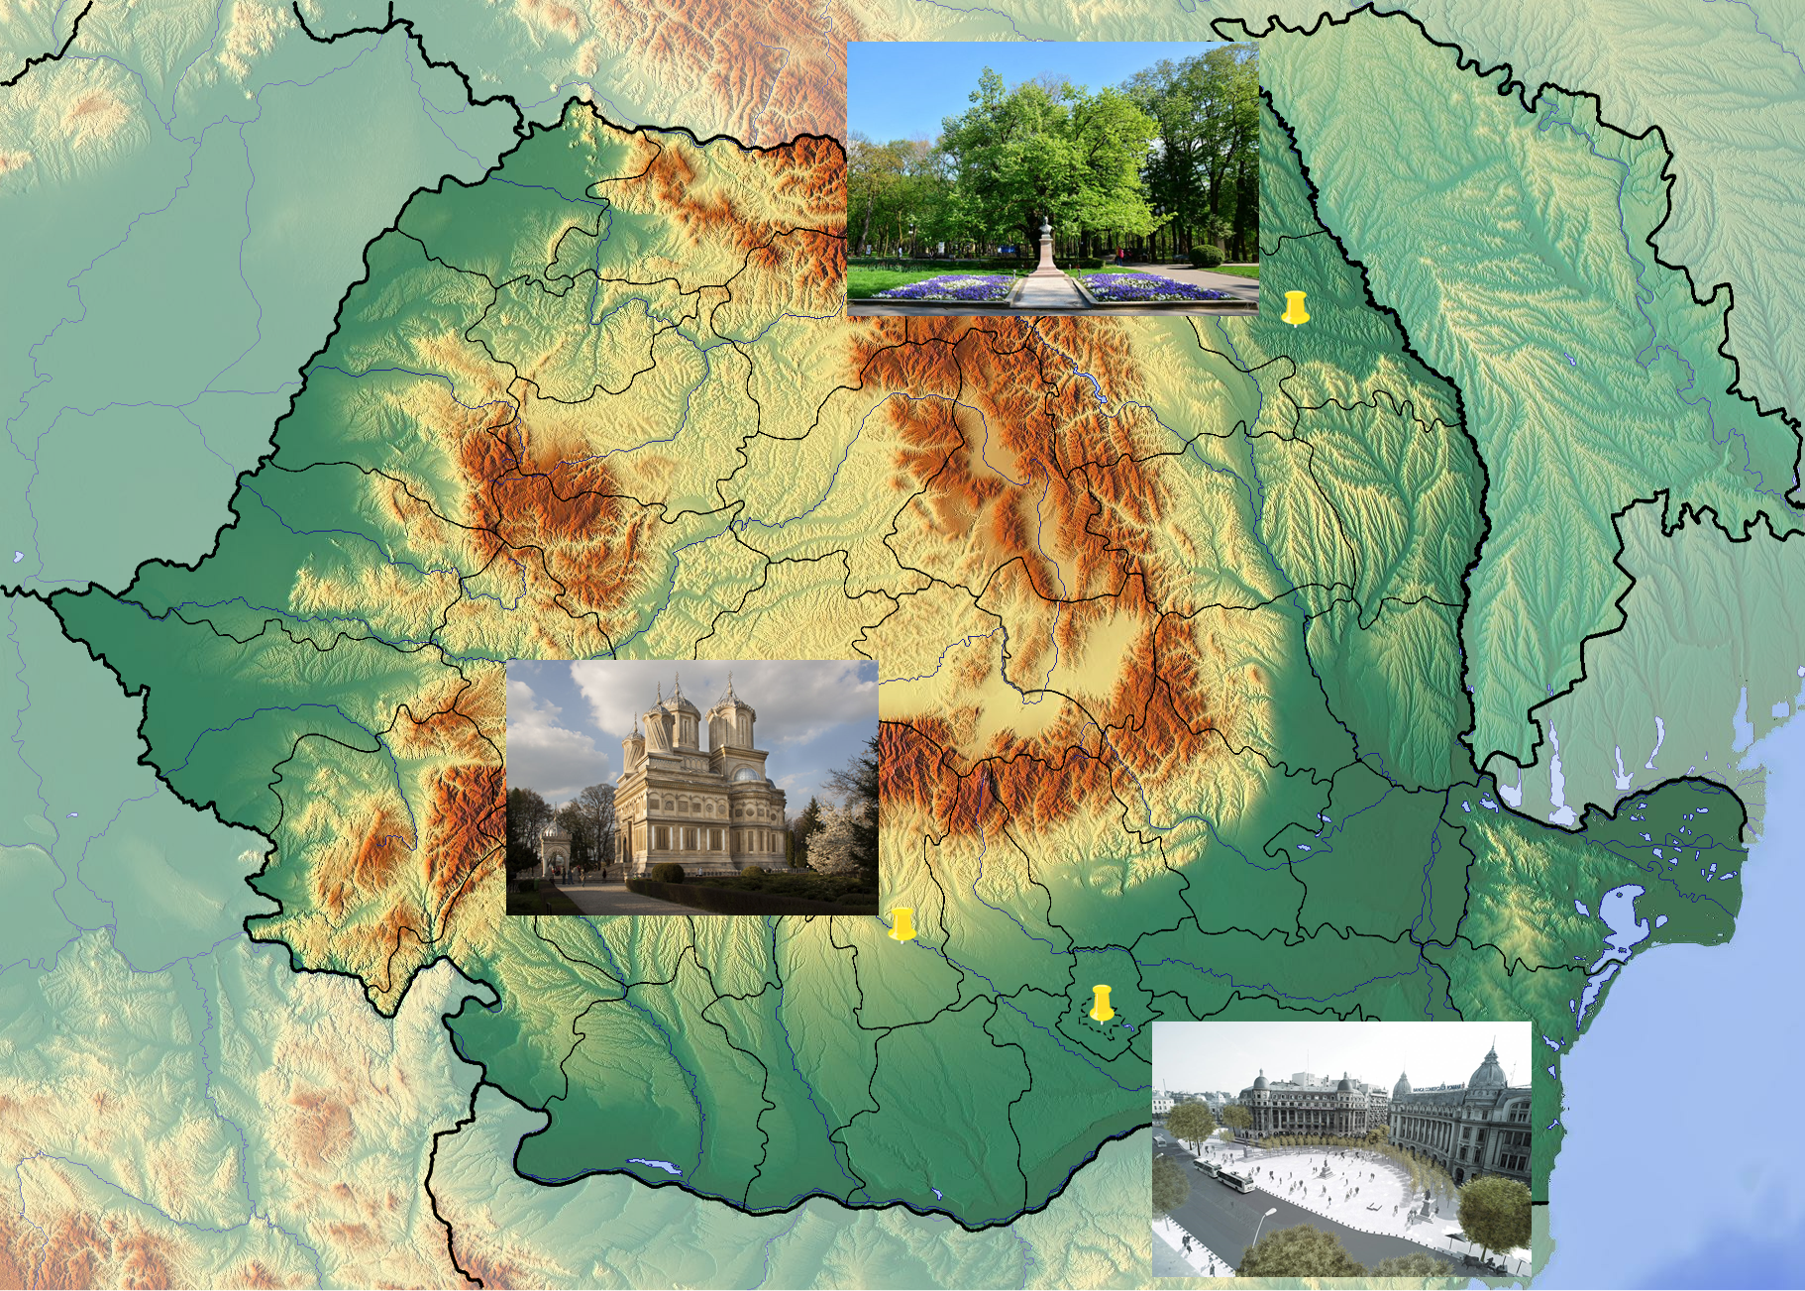

Slide 3
Research question
What is the purpose of your visit to the monument/place?
What does this place represent to you? Does it have a certain meaning to you?
What do you know about the place, historical event or symbolism?
How does this place make you feel?
When you refer to this place, how do you call it?

Slide 4
Methodology
Qualitative research on the field (interviews)
Direct observation
Research online

Slide 5
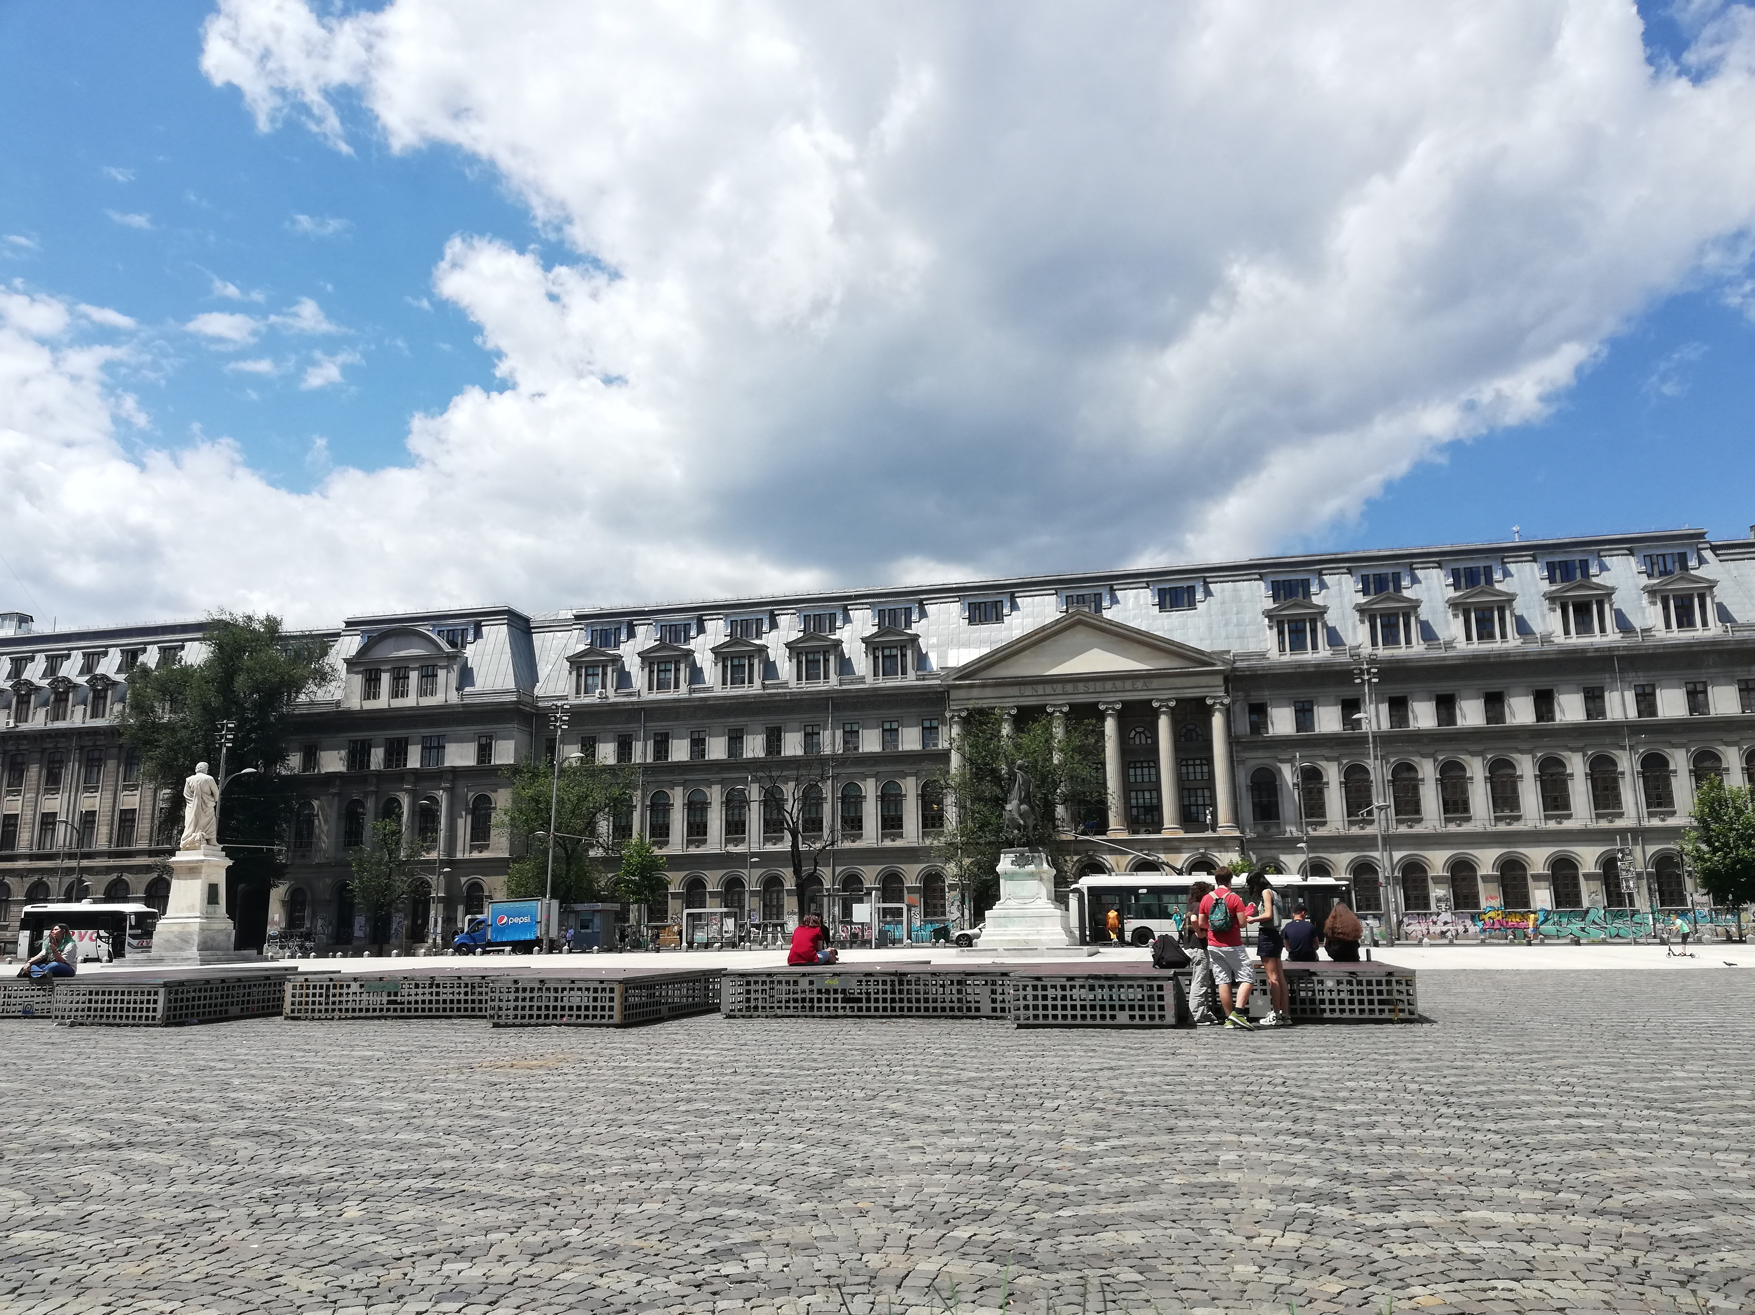
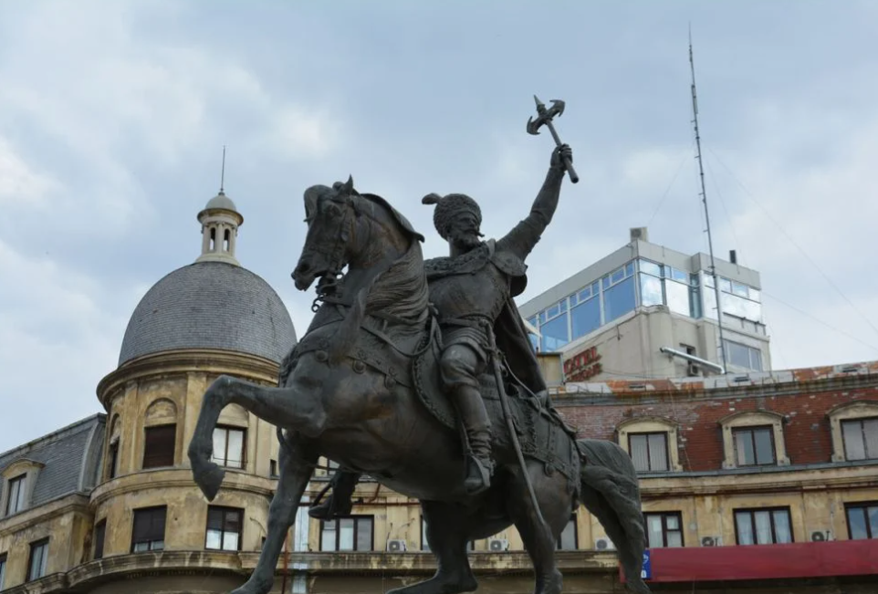
University Square, Bucharest

Slide 7
Research result
Tourists stop for photos at the statues
Young people stay for meet ups
The restaurants are full of people enjoying the sun
Lots of traffic
10 interviews
Key words: Zone 0, University, meeting place

Slide 8
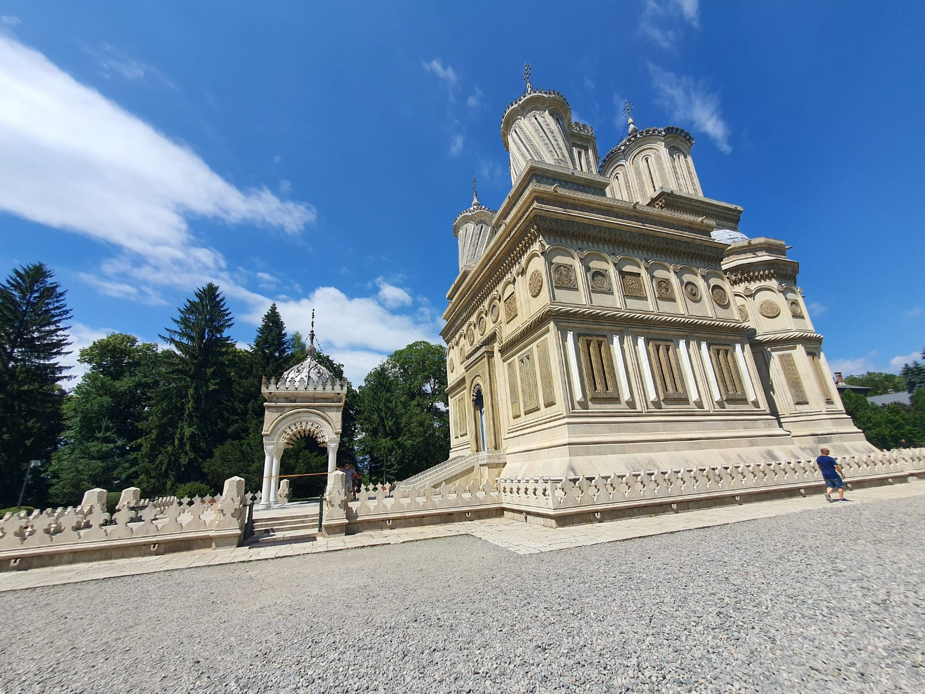

Slide 9
Cathedral Curtea de Argeș
Founded by Prince Neagoe Basarab(1512-1521)
Completed by Radu de la Afumați in 1526
Build in two architectural style: Byzantine and arabesque
Inspired many Romanian poets such as Vasile Alecsandri or Lucian Blaga
Functionalities: A church, A mythical place, A “tomb”
The Legend of Manole
A legend tells of Radu Negru employing a Meşterul Manole or Manoli as architect. With Manole being unable to finish the walls, the prince threatened him and his assistants with death. At last Manole suggested that they should follow the ancient custom of placing a living woman into the foundations; and that she who first appeared on the following morning should be the victim. The other masons warned their families, and Manole was forced to sacrifice his own wife. Thus the cathedral was built.

Slide 10
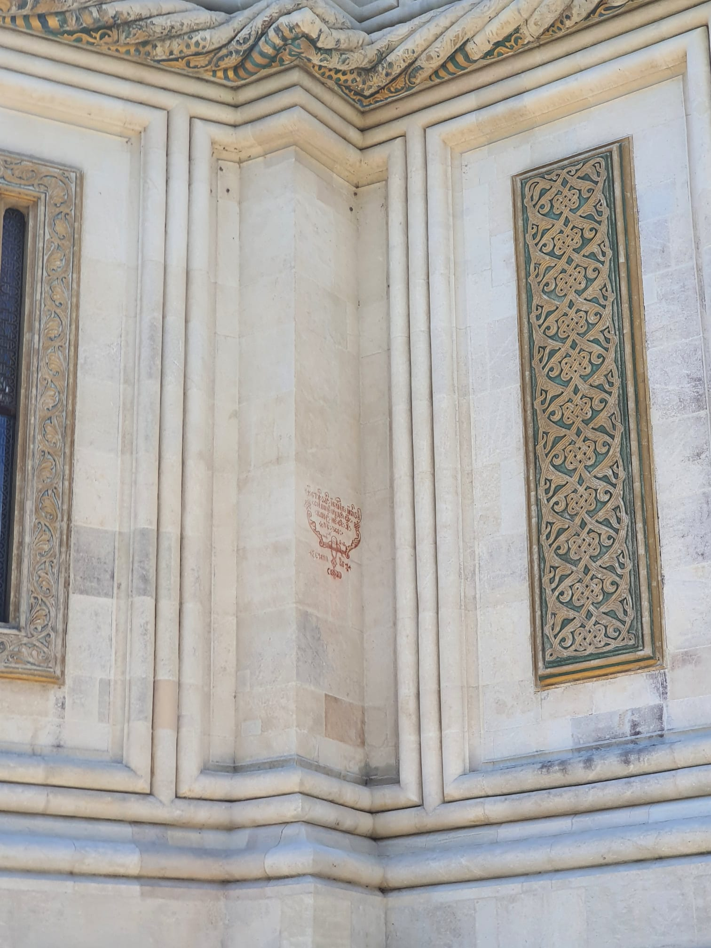
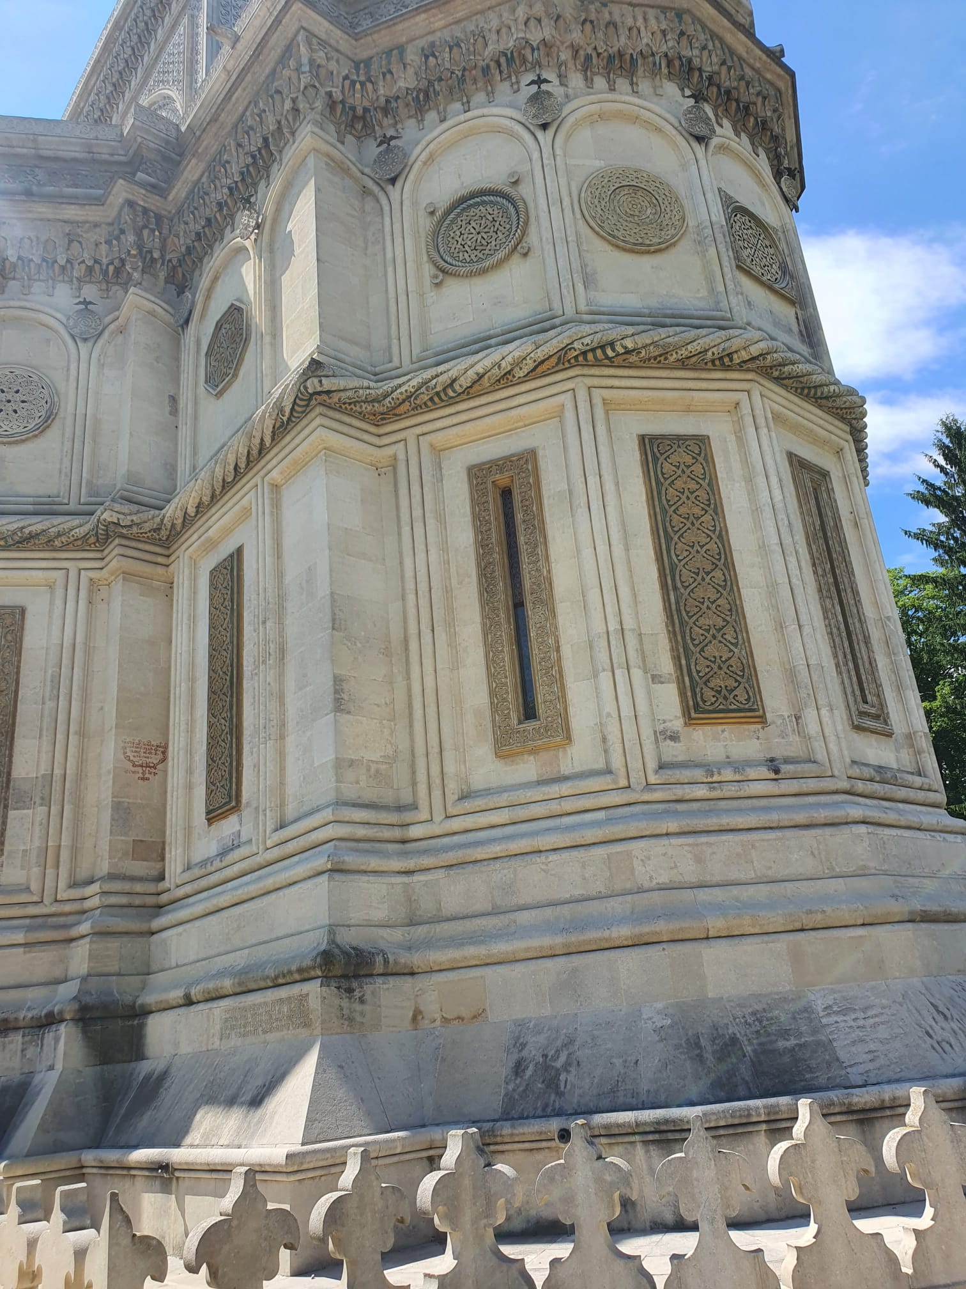
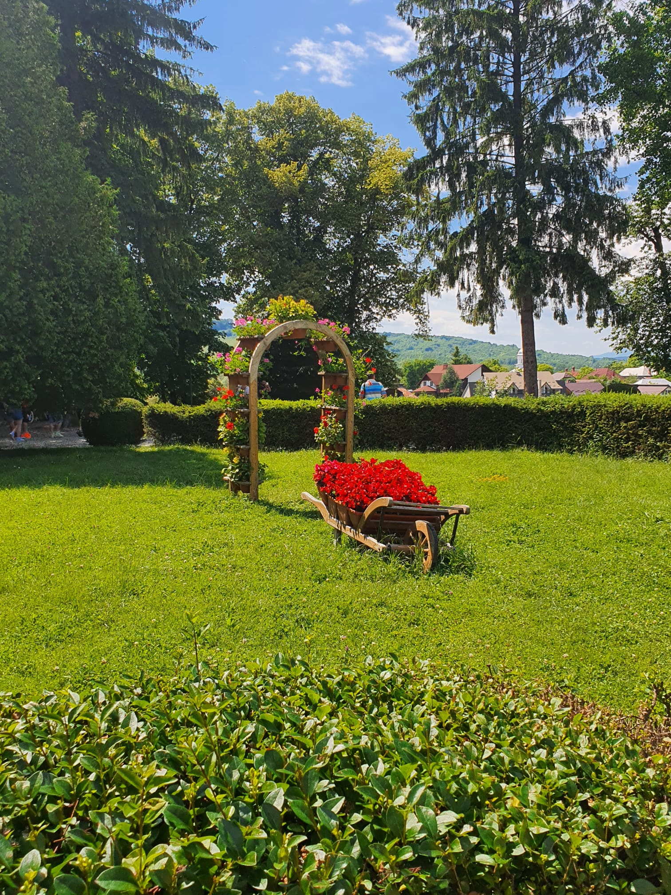
Cathedral Curtea de Argeș

Slide 11
Burials from Curtea de Argeș
Neagoe Basarab V, Reigning Prince of Wallachia
Despina Princess Consort of Wallachia
Petru, Prince of Wallachia
Ion, Prince of Wallachia
Anghelina, Princess of Wallachia
Stana, Princess of Wallachia and Princess Consort of Moldavia, wife of Stephen IV of Moldavia
Radu V, Reigning Prince of Wallachia
Ruxandra, Princess of Moldavia and Princess Consort of Wallachia, wife of Radu V of Wallachia
Carol I, King of Romania
Elisabeth, Queen of Romania
Maria, Princess of Romania
Ferdinand I, King of Romania
Marie, Queen of Romania
Carol II, King of Romania
Michael I, King of Romania
Anne, Queen of Romania
Helen, Queen Mother of Romania
Mircea, Prince of Romania

Slide 12
Research Result - Curtea de Argeș
First observation: People come in this place from different parts of Romania.
What people are doing here: walking, taking pictures, observ, talking, play with children, stay and relax, praying, working
6 interviews - age between 19 and 50 years - 4 men and 2 women
Key word for this monument: spirituality and beautiful
People before answer my questions: suspicious
People answering my questions: free in speech and open
The purpose of people who came and answer my questions: relax, admiring the place, visit, work and pursue their personal purpose

Slide 13
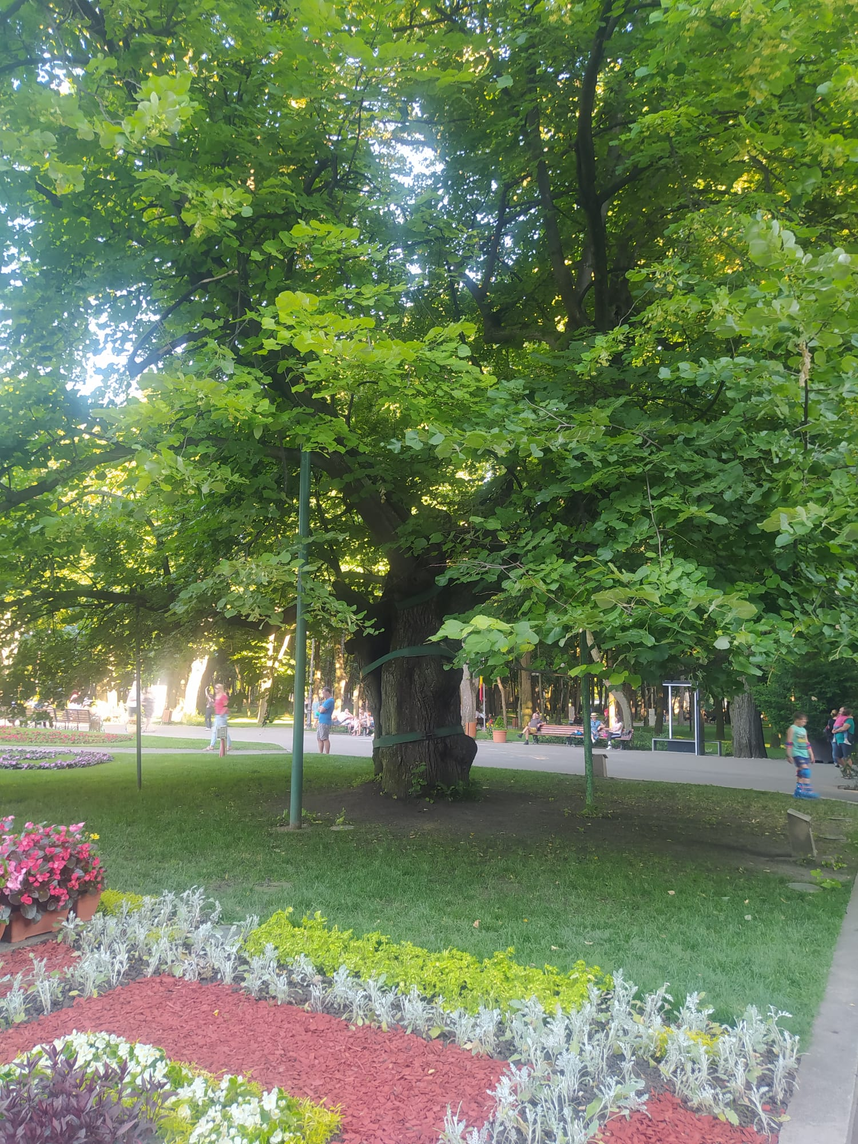
Mihai Eminescu’s Linden Tree
a natural monument, located in Copou Park, Iași.
it is a 540 years linden tree, sustained by metal fixings, under which Mihai Eminescu (b.1850-d.1889) used to come and rest occasionally.
it is said that the poet used to come and write poetry under that exact tree.

Slide 14
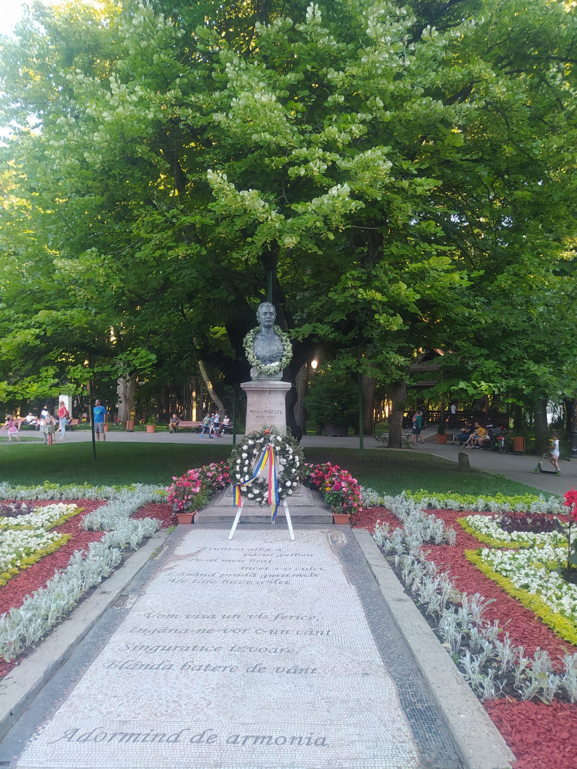

Slide 15
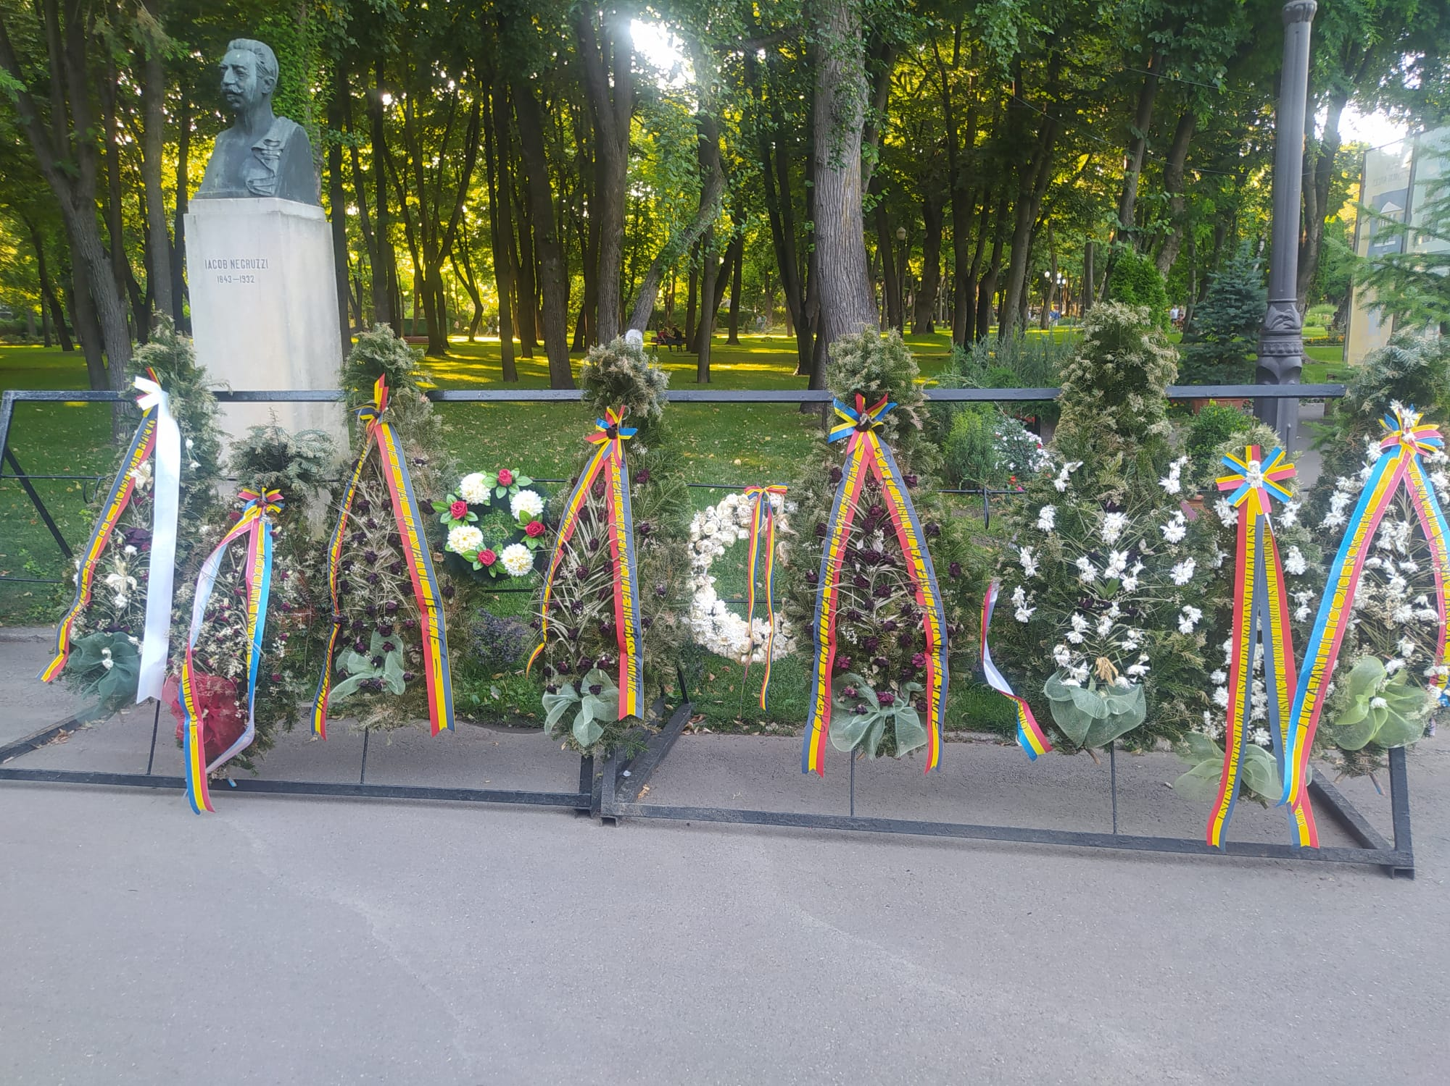

Slide 16
Research Results
3 interviews, aged 26 to 70, two females one male.
What people are doing here: taking a walk in the park, meeting with friends, visiting, spending time with family in nature.
Key words: nostalgia, literature, romance.

